Slide 1
What’s going on in
Bromley town centre?
Peter Martin
7th April 2022

Slide 2
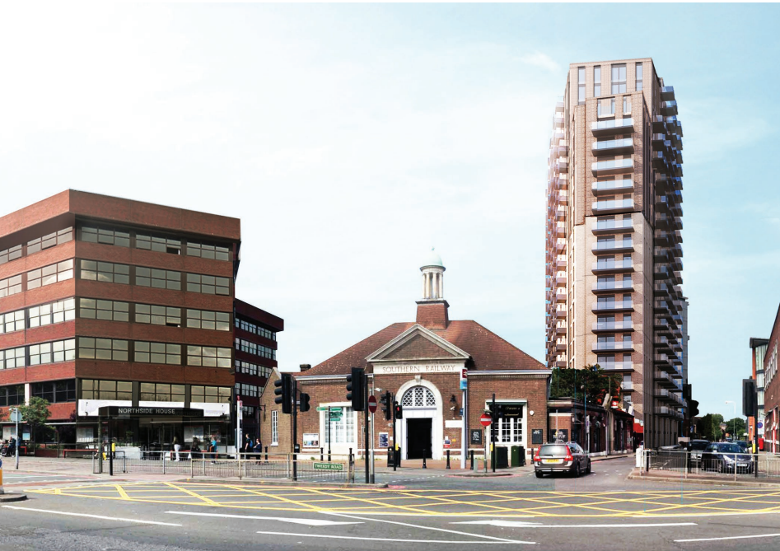
6-10 Sherman Road
Refused: October 2018

Slide 3
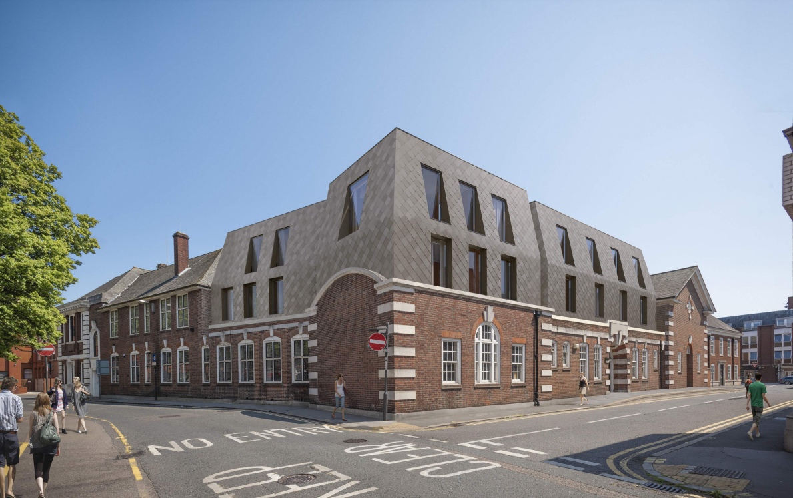
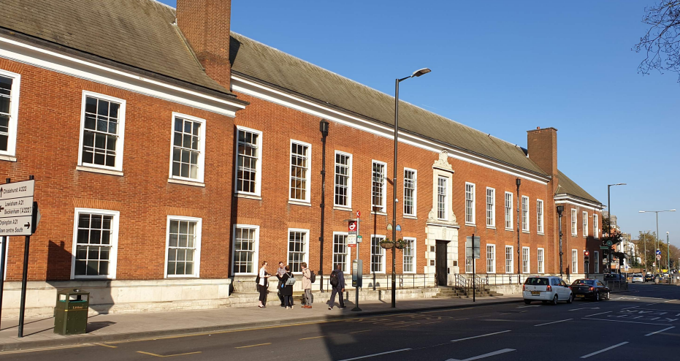
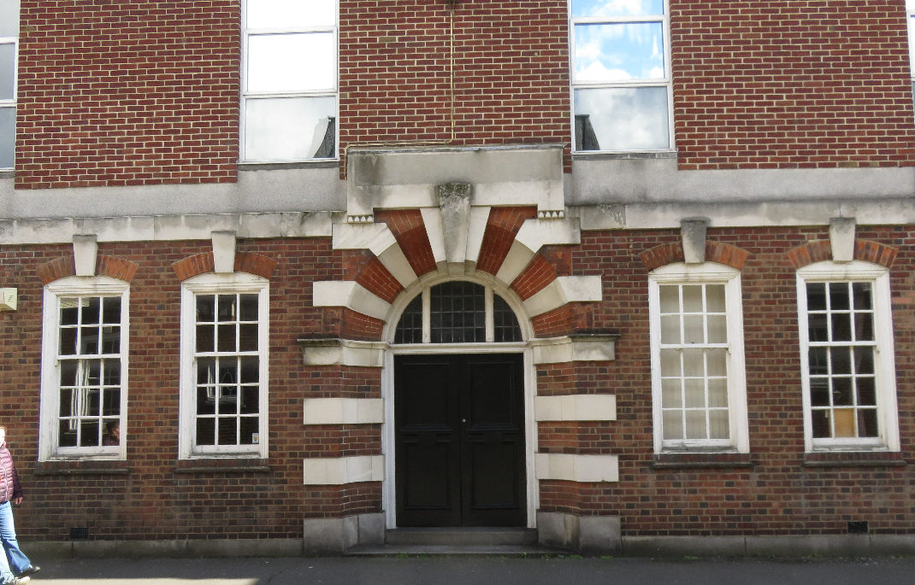
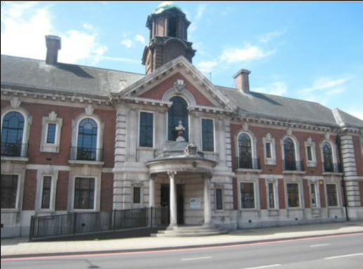
Old Town Hall
Permitted: 12 Mar 2021

Slide 4
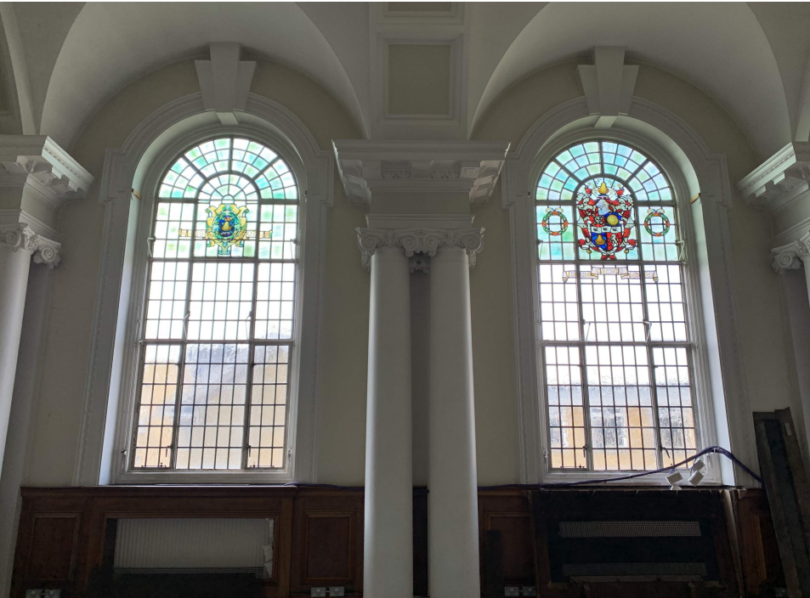
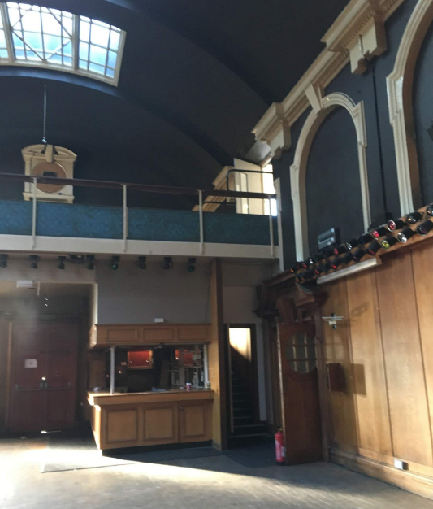
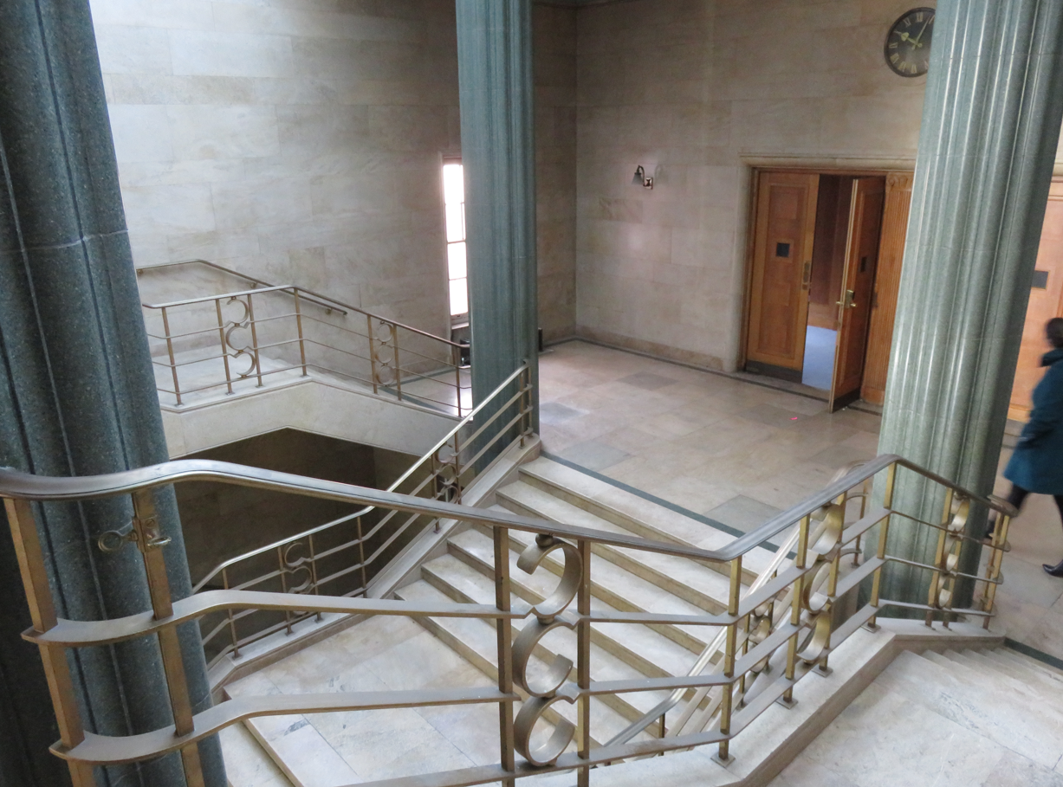
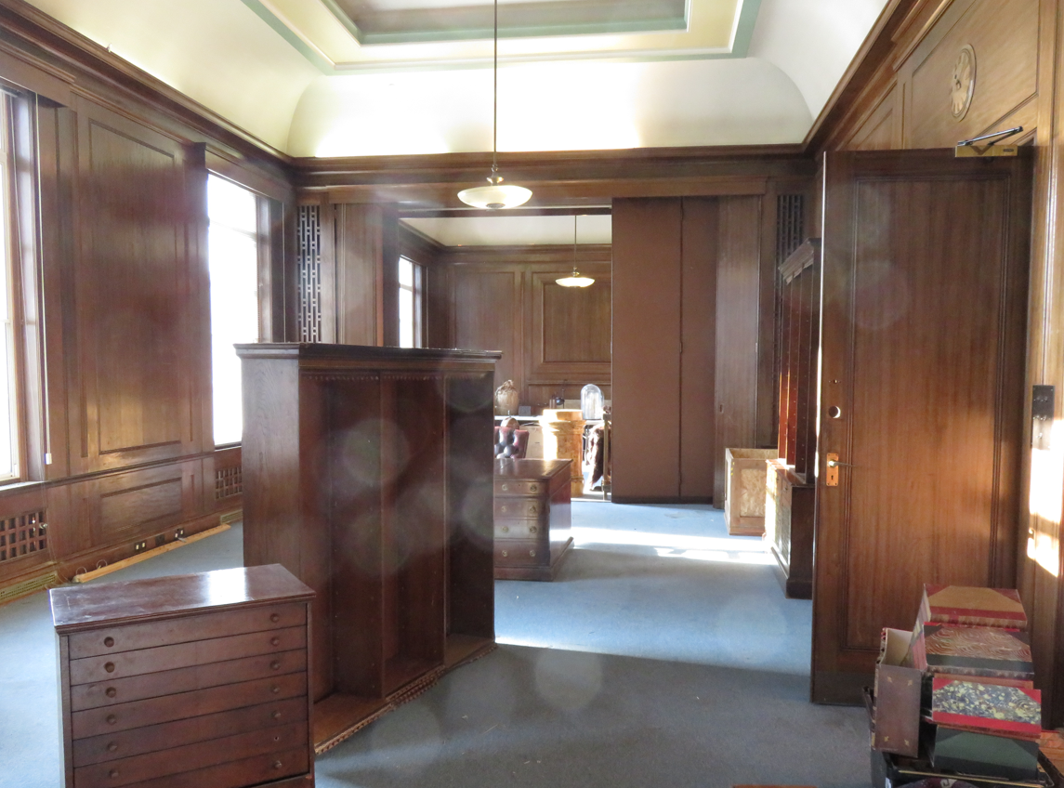
Old Town Hall
Permitted: 12 Mar 2021

Slide 5
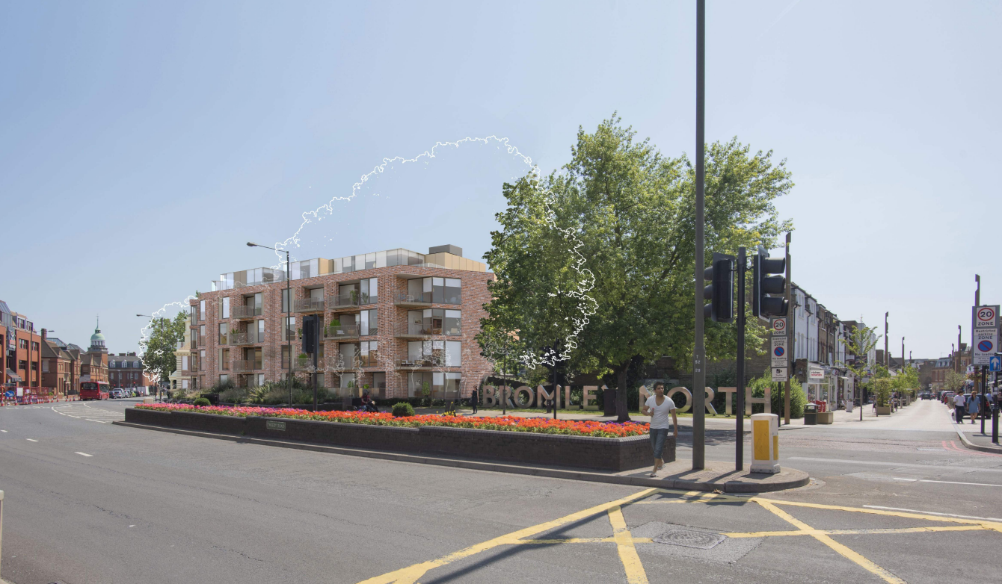
South Street
Permitted: 12 Mar 2021

Slide 6
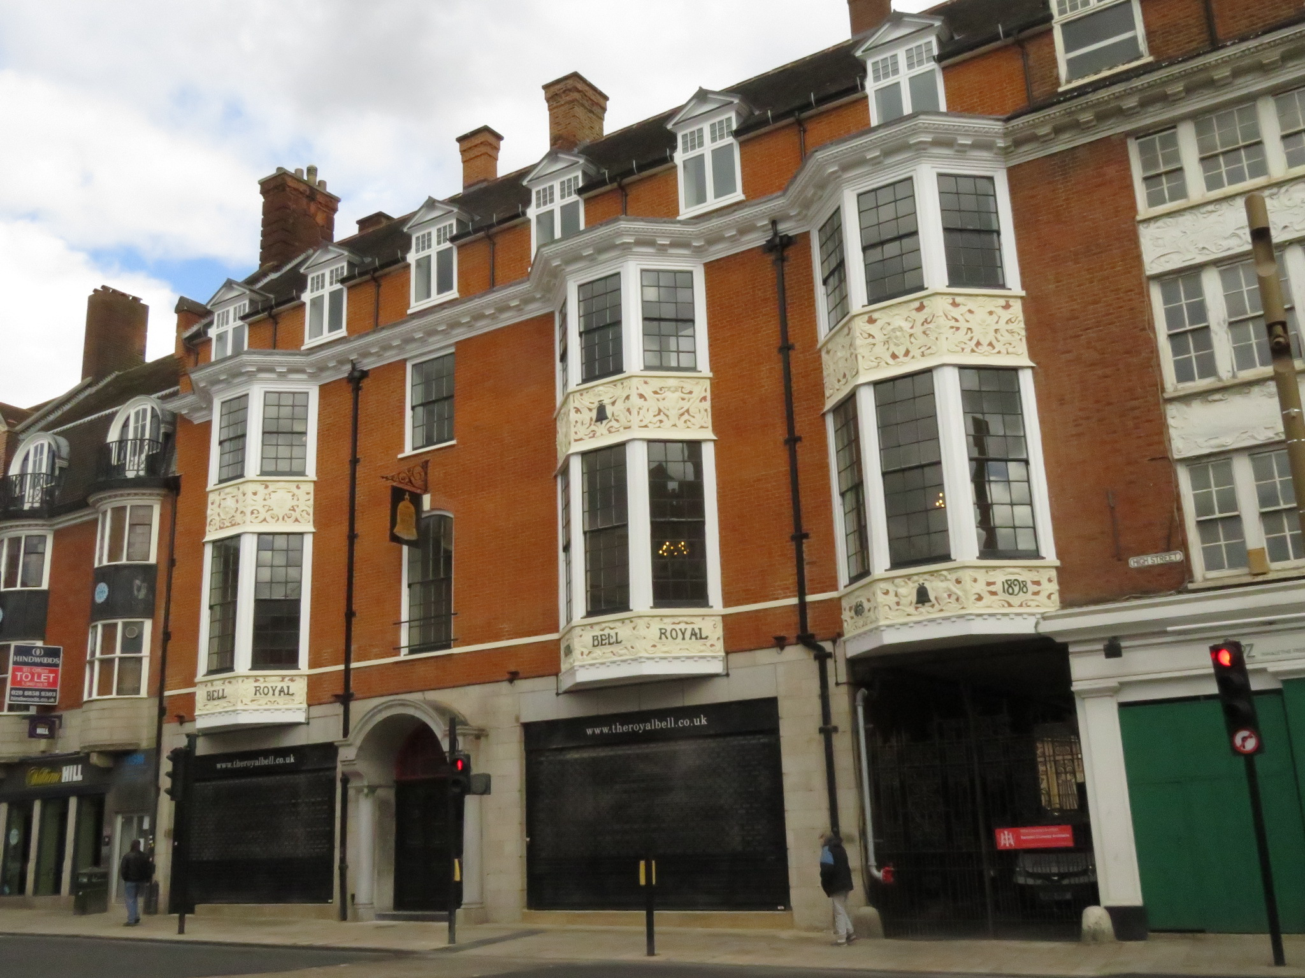
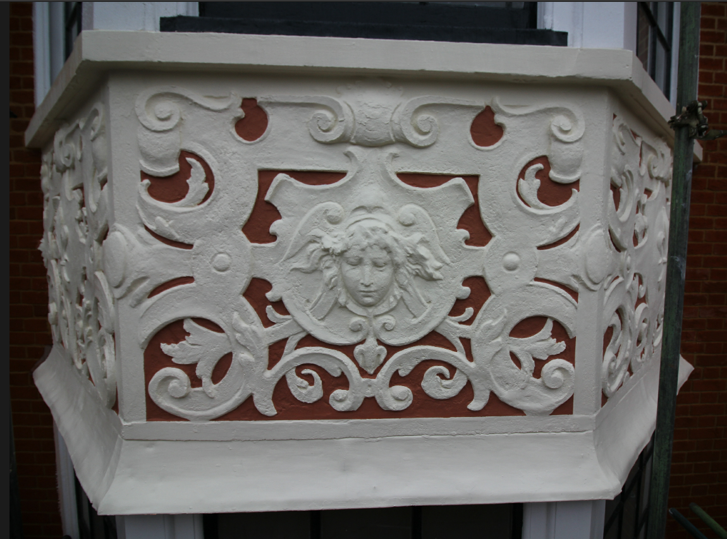
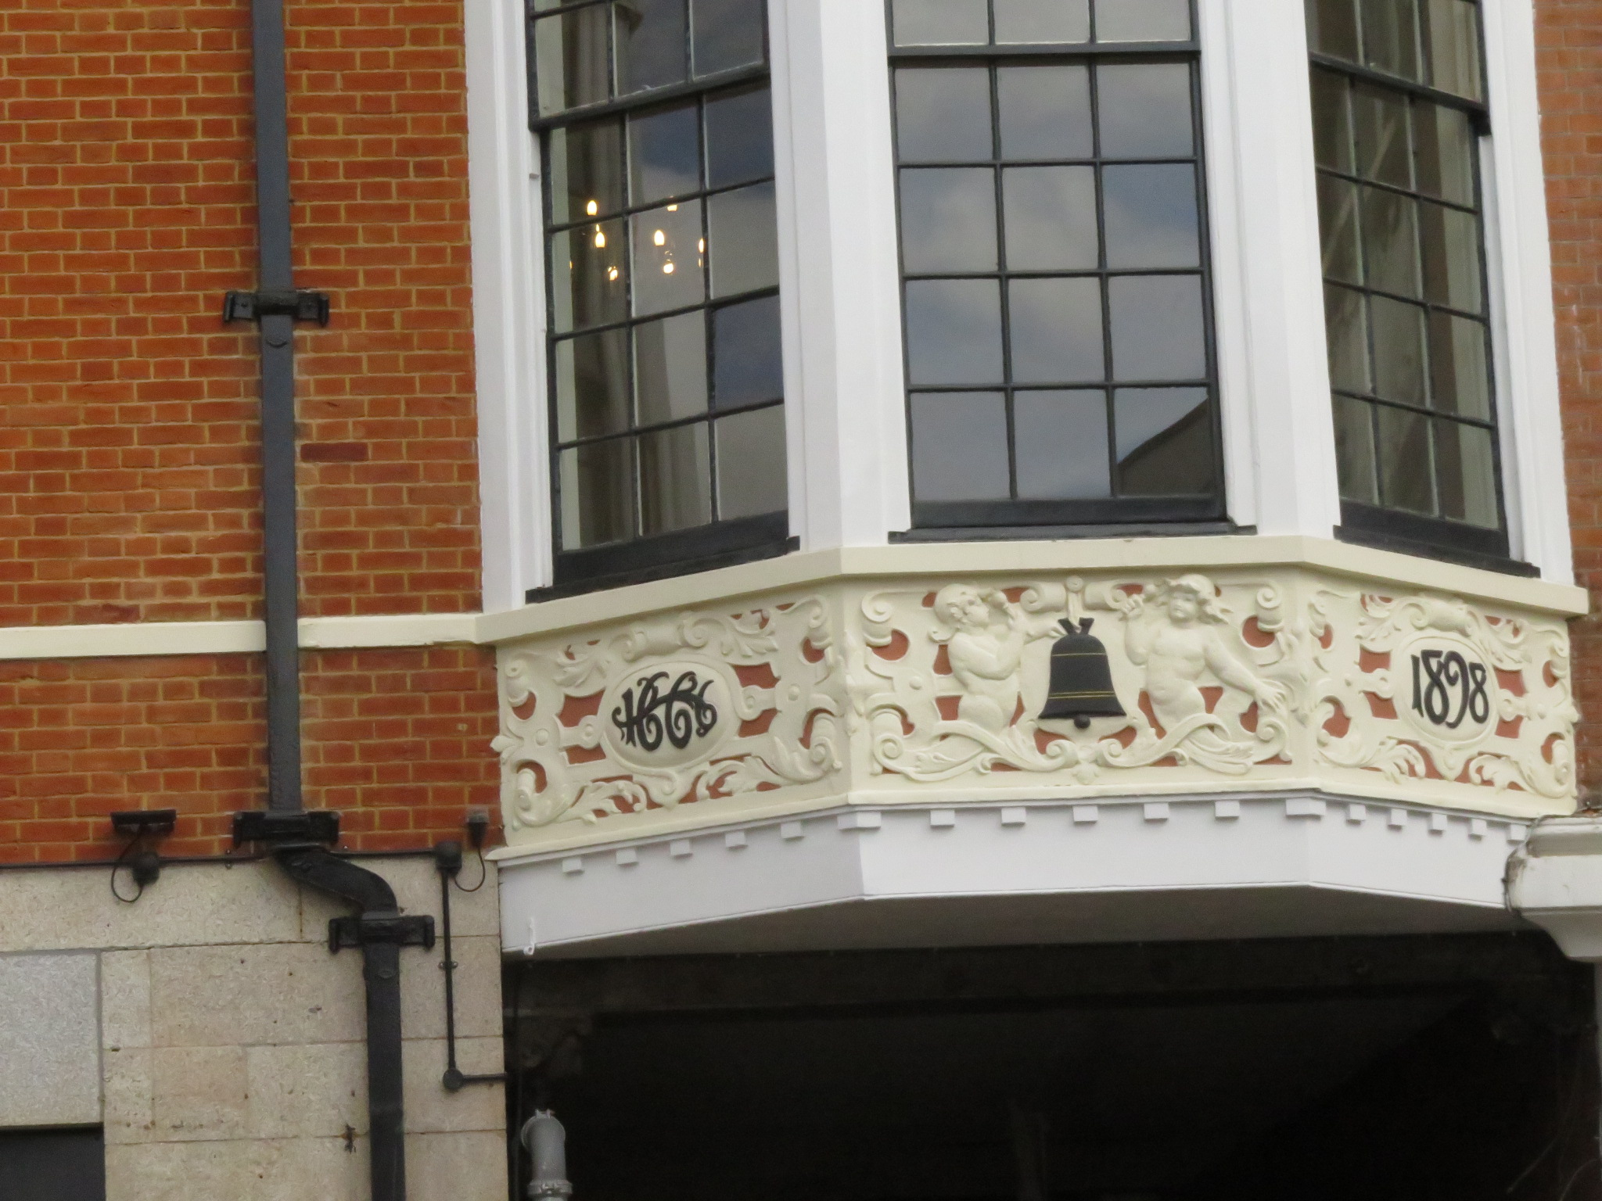
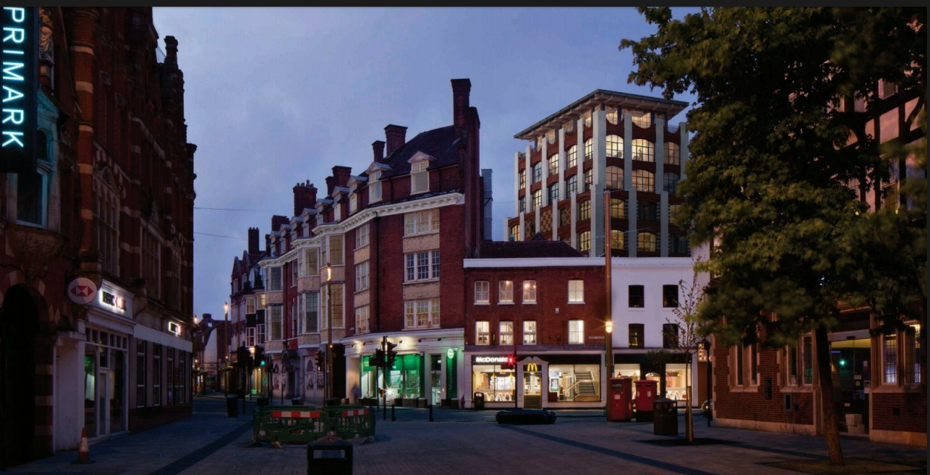
Royal Bell

Slide 7
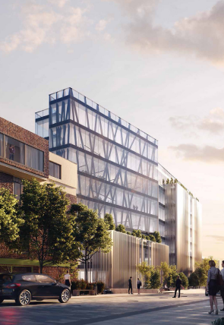
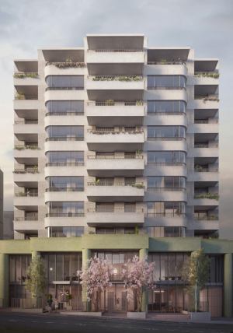
Elmfield Road
15 Elmfield Road
19 Elmfield Road
Permission granted April 2021
Permission granted June 2021

Slide 8
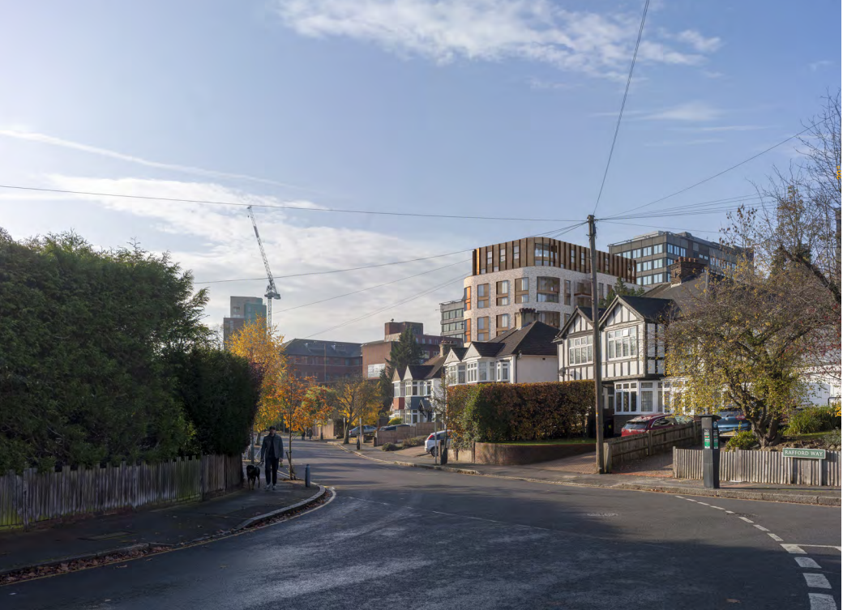
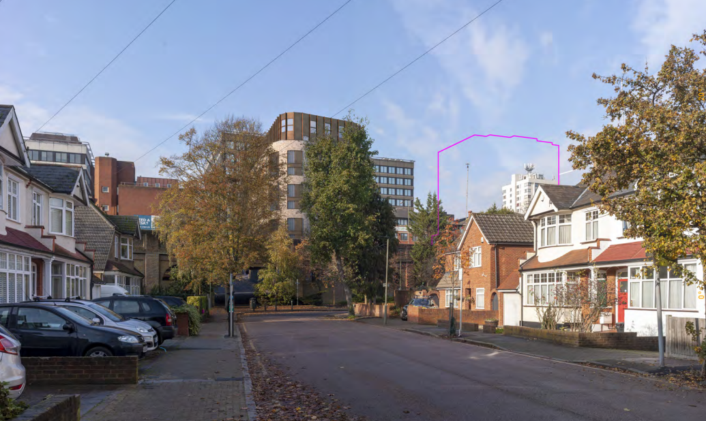
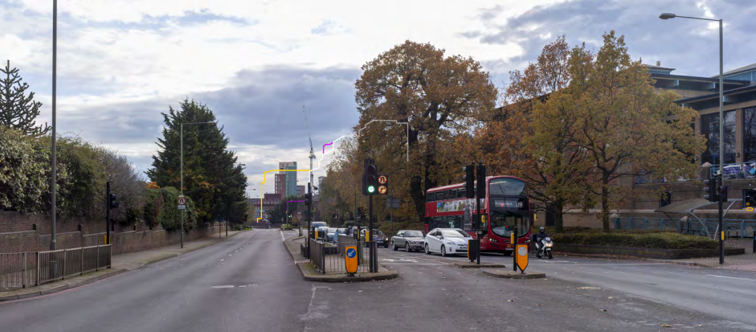
Conquest House, 25 Elmfield Road
9 storeys
Awaiting decision
21/05420/FULL1

Slide 9
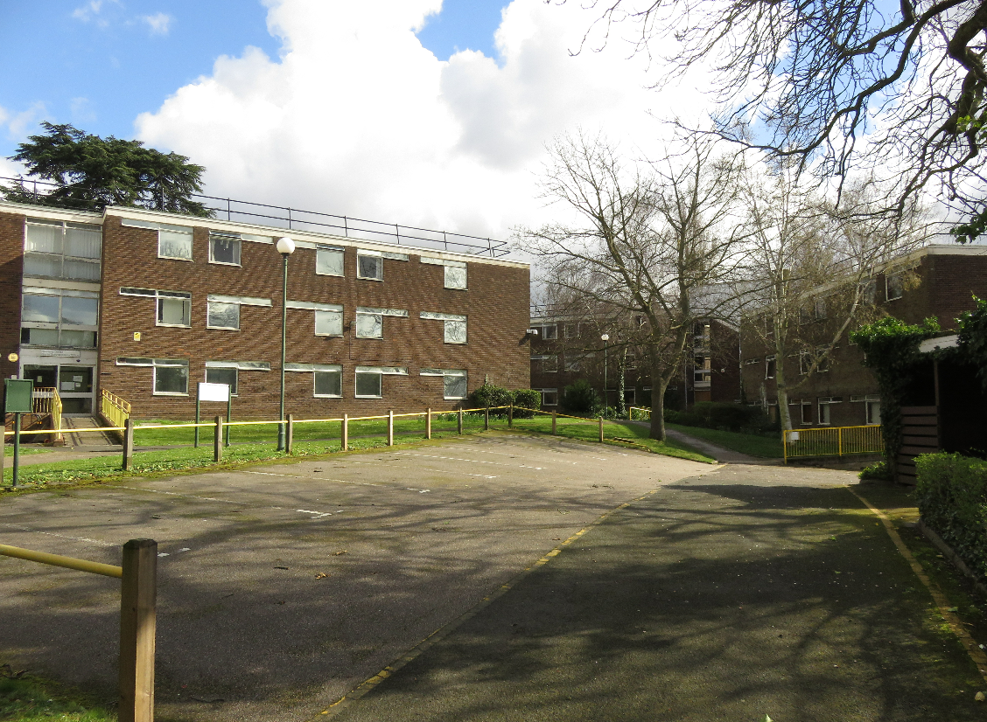
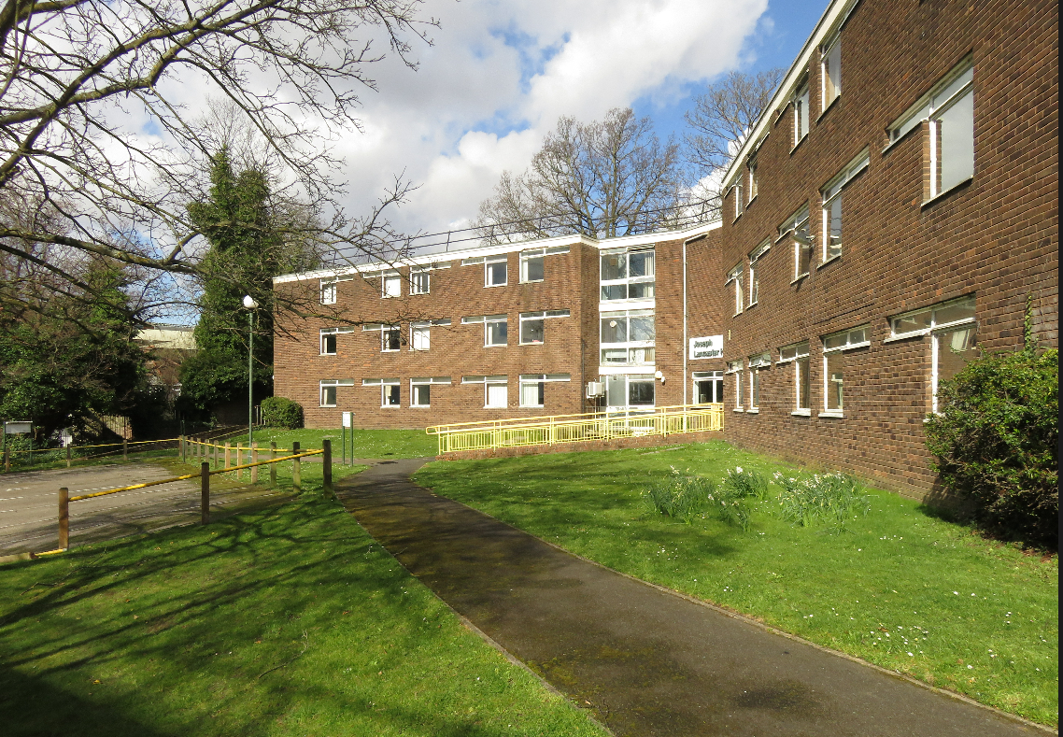
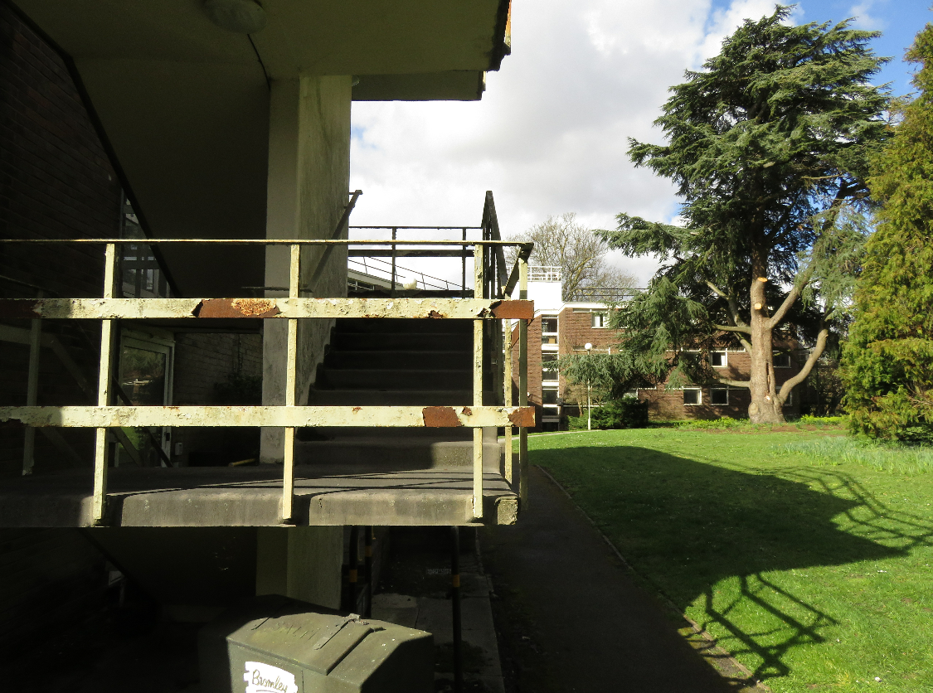
Y-Buildings, Civic Centre
Prior approval granted
September 2021
72 dwellings

Slide 10
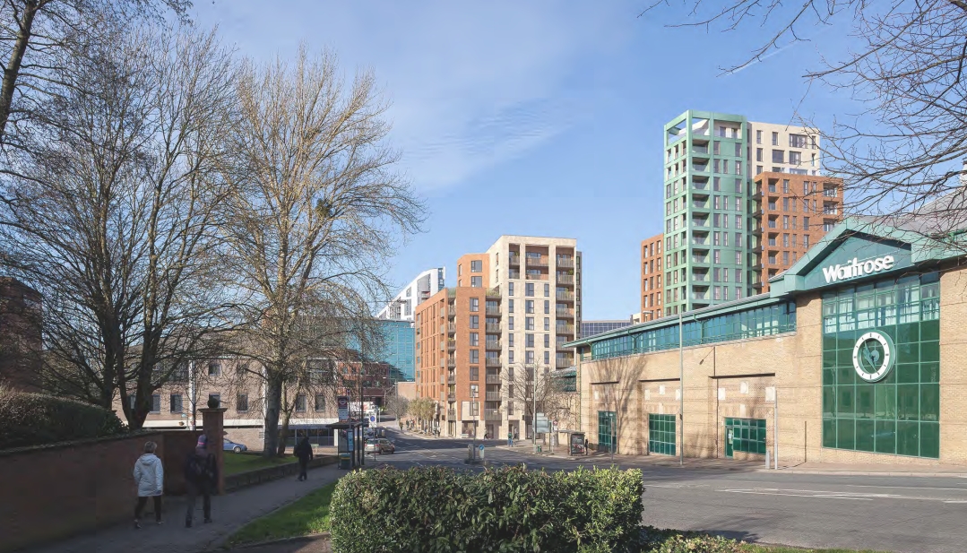
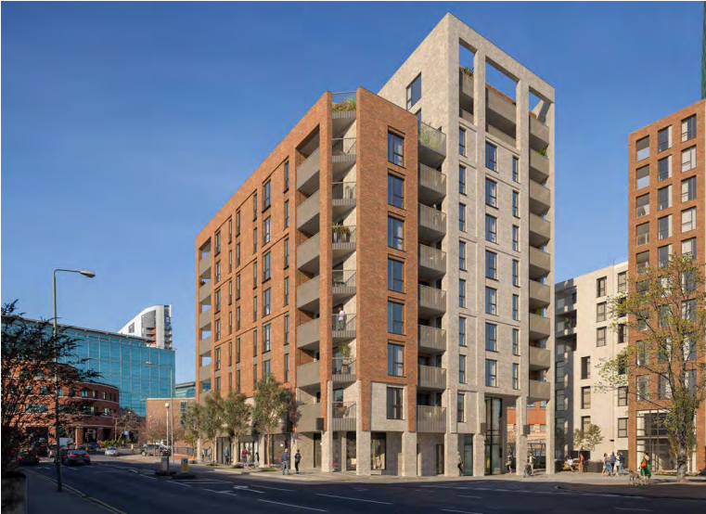
33-41 MASONS HILL
part 8/part 11 storey
Awaiting decision
21/00741/FULL1

Slide 11
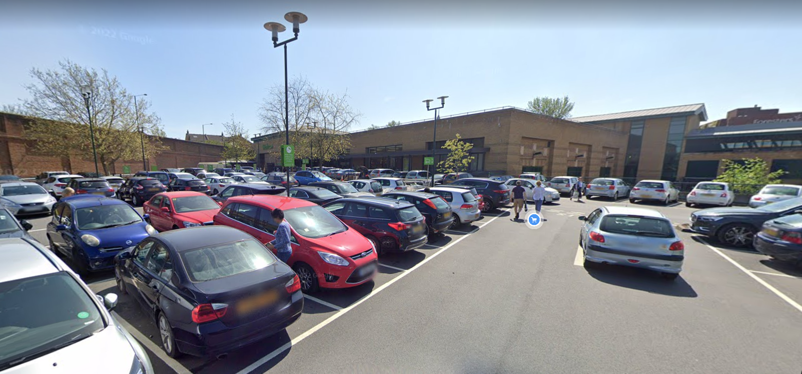
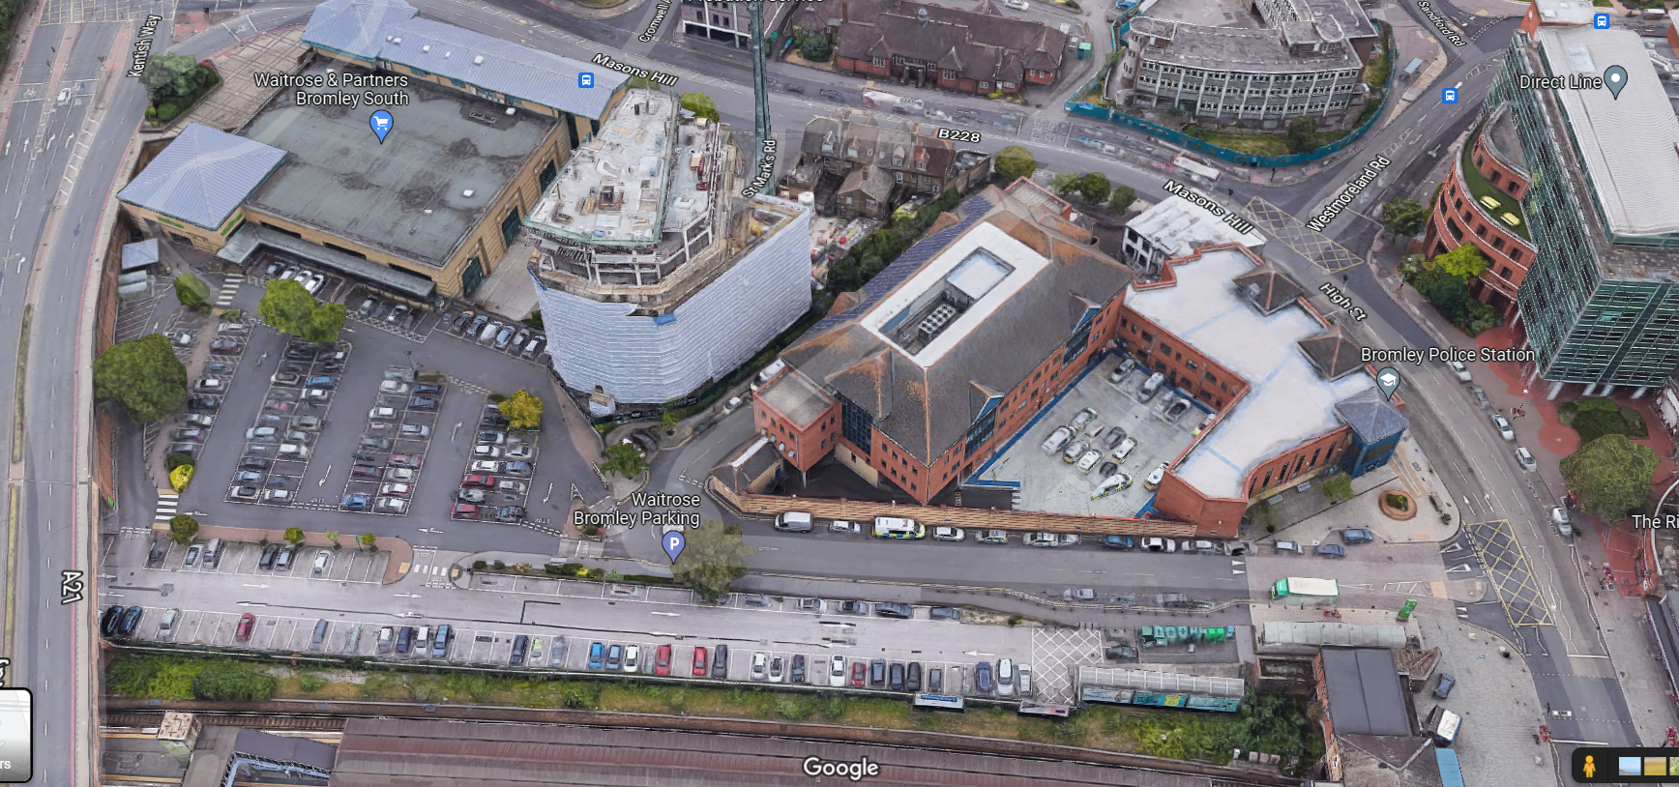
Waitrose – John Lewis
Watch this space…

Slide 12
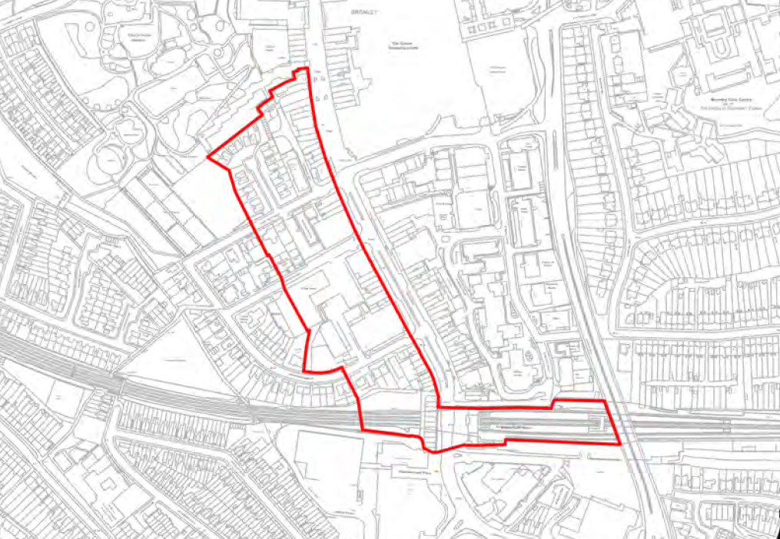
Site G/10

Slide 13
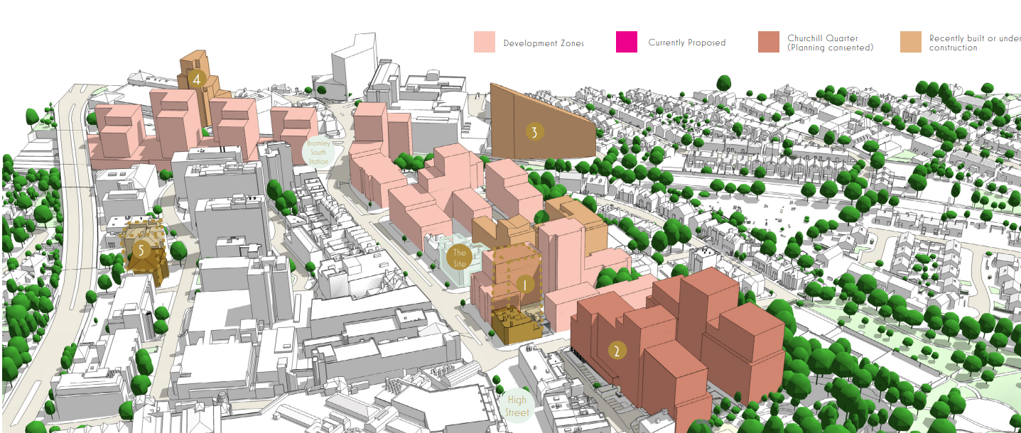
Masterplan

Slide 14
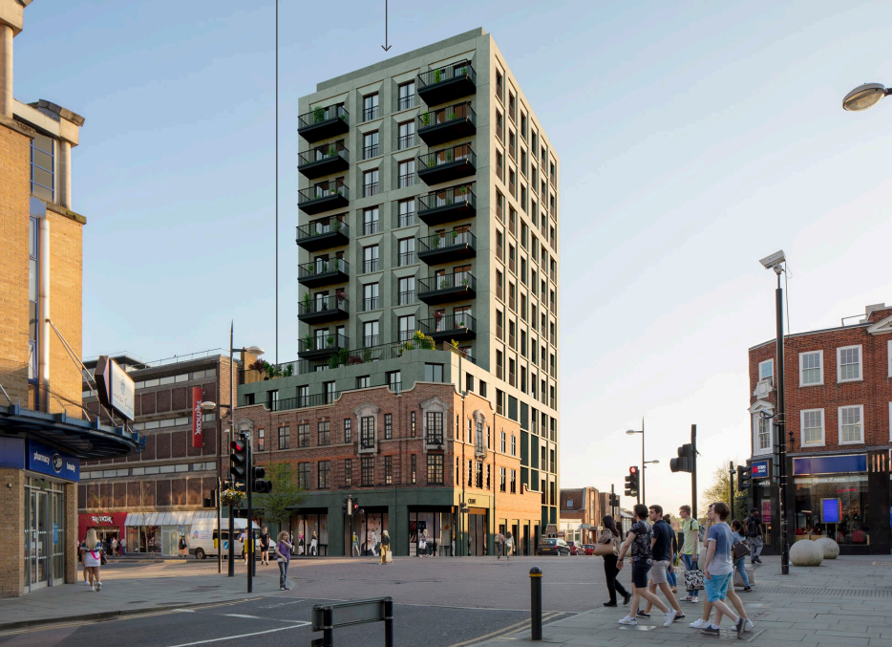
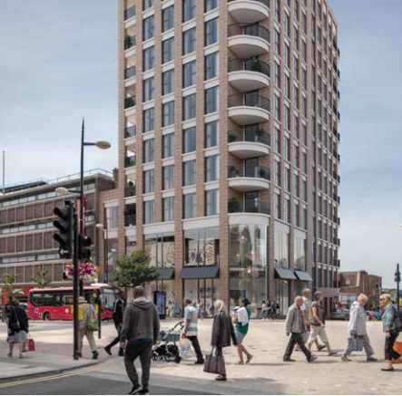
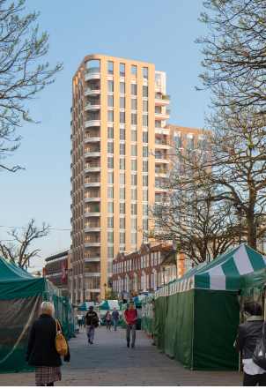
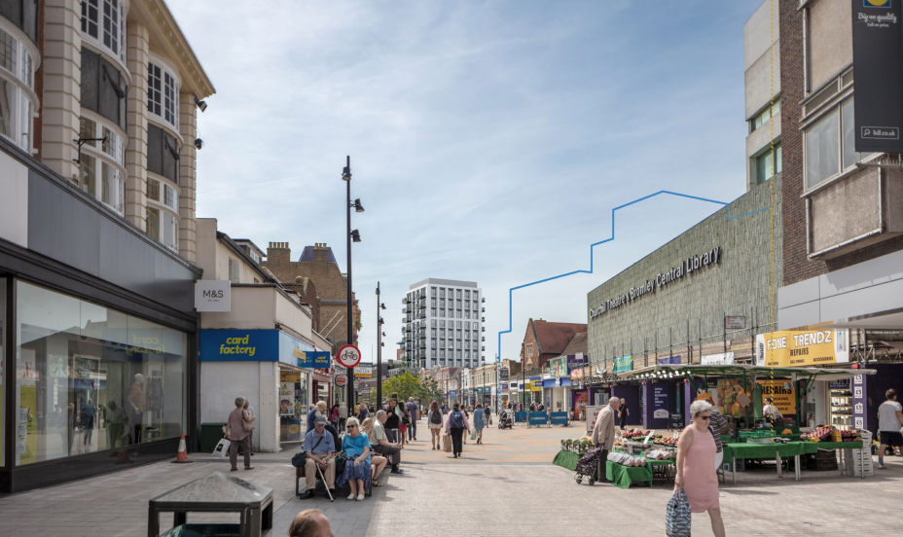
Former Maplins, 70 High St
part 4/part 12 storey; 47 units
part 13/part 16 storey; 68 units
part 13/part 16 storey; 68 units
Refused April 2021
Both schemes awaiting appeal

Slide 15
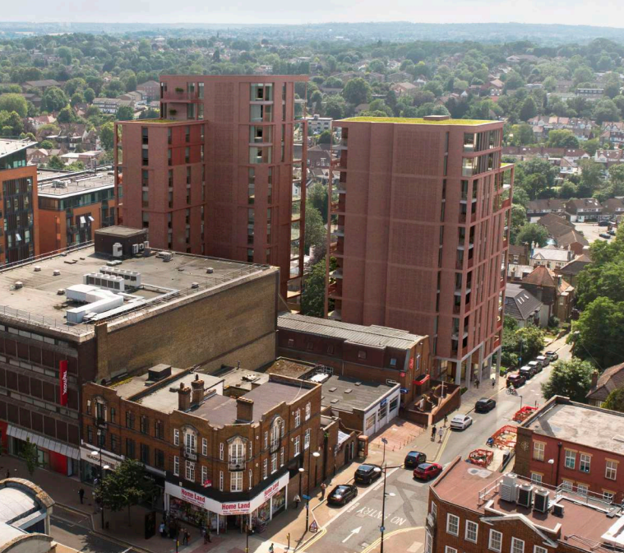
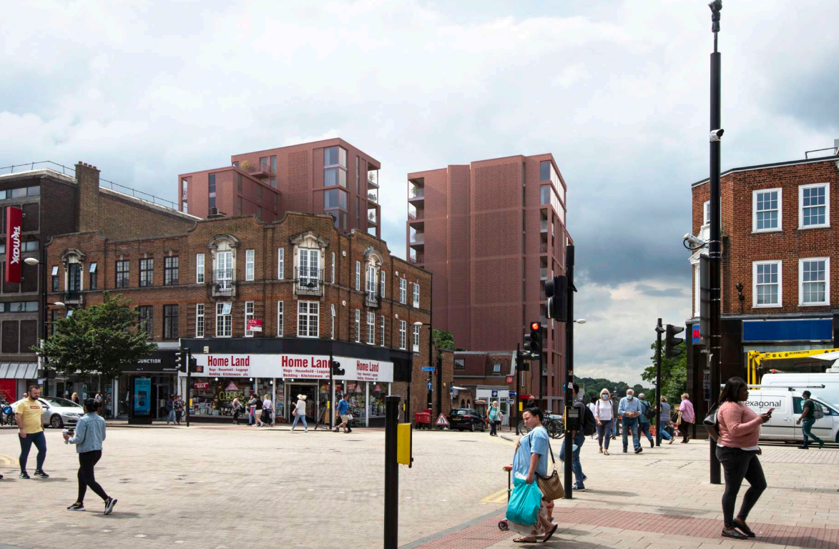
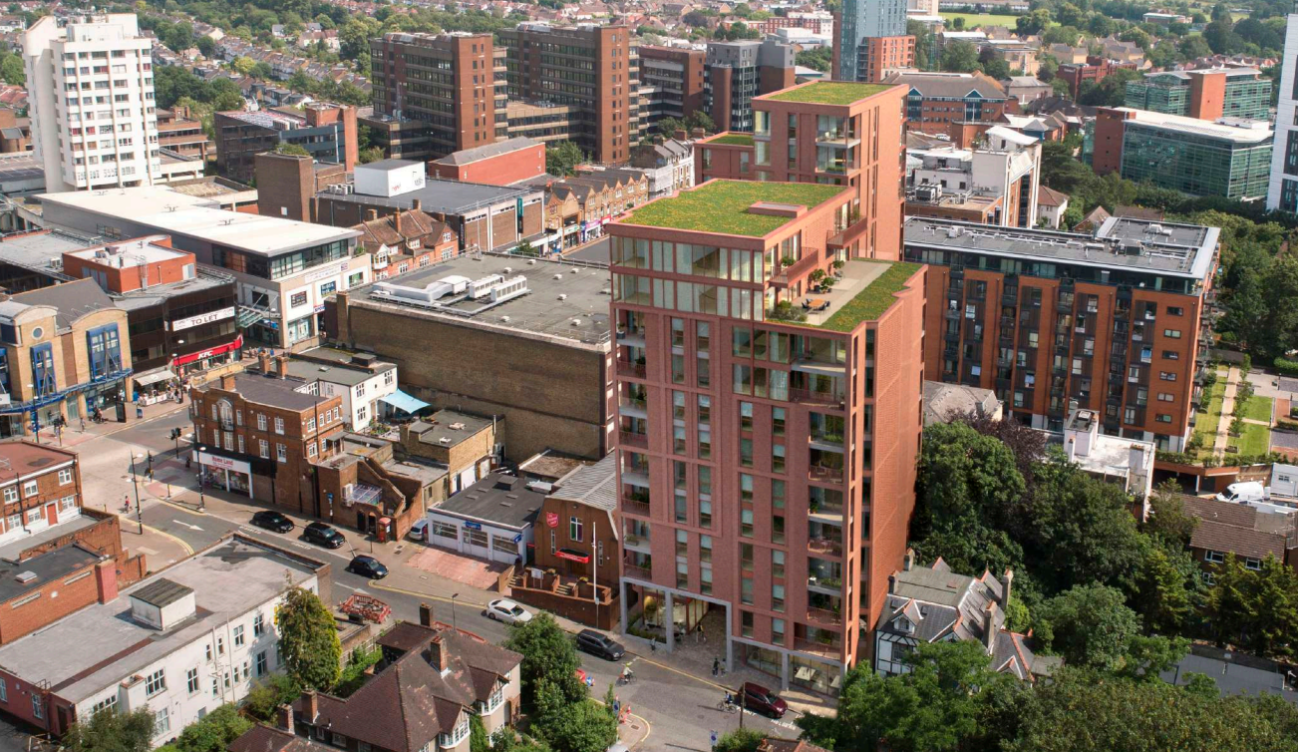
2-4 Ringers Road
Awaiting Decision
21/05585/FULL1

Slide 16
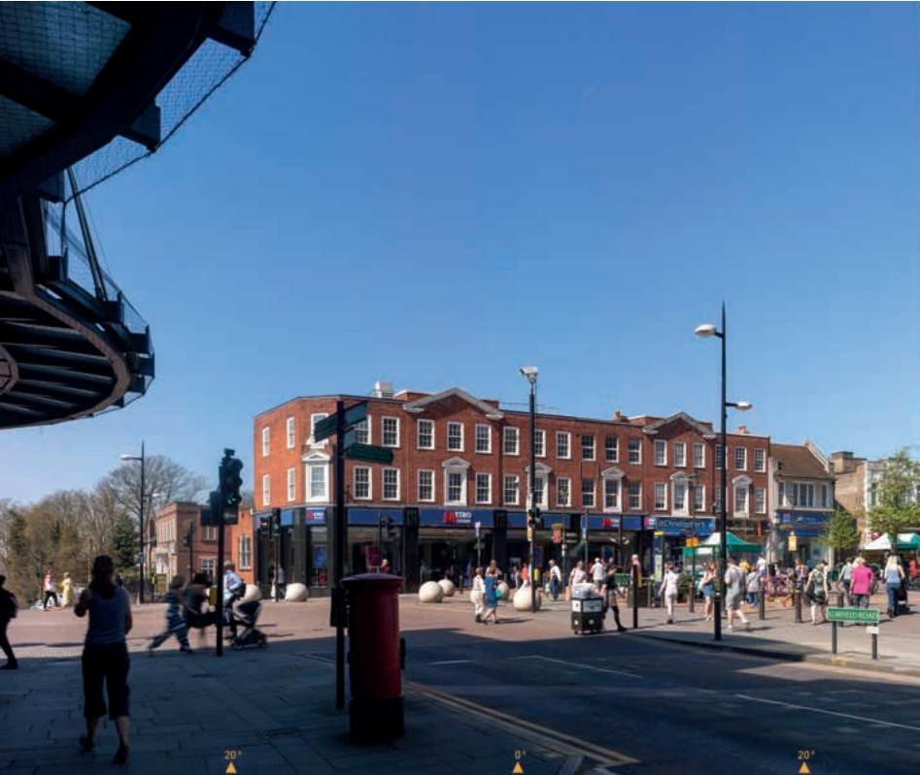
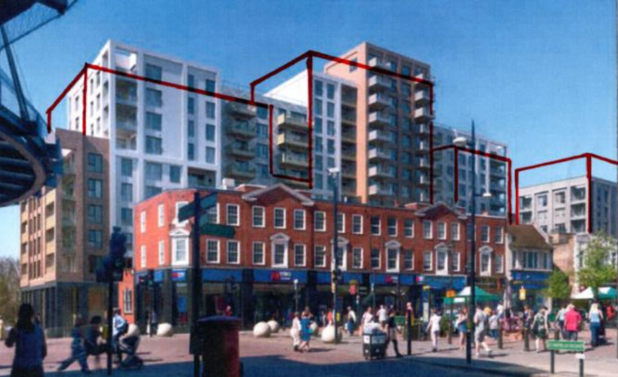
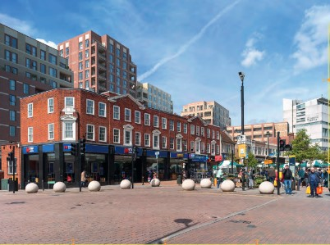
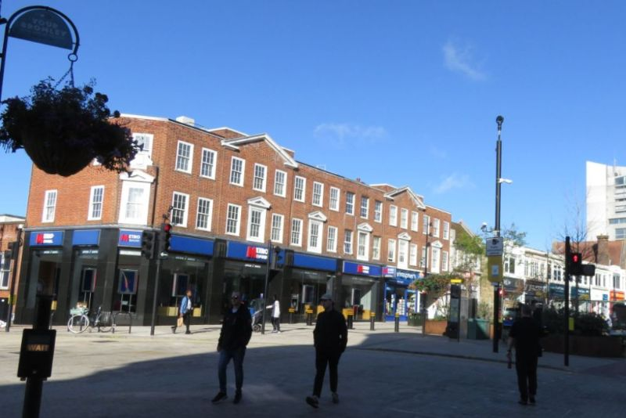
Churchill Quarter
7 towers
7-15 storeys high
413 dwellings

Slide 17
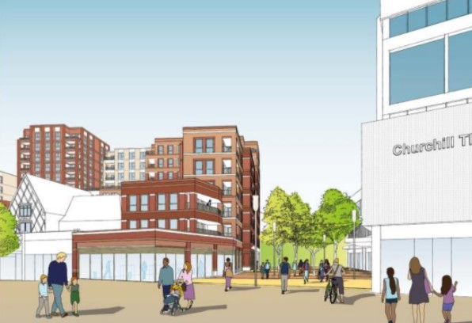
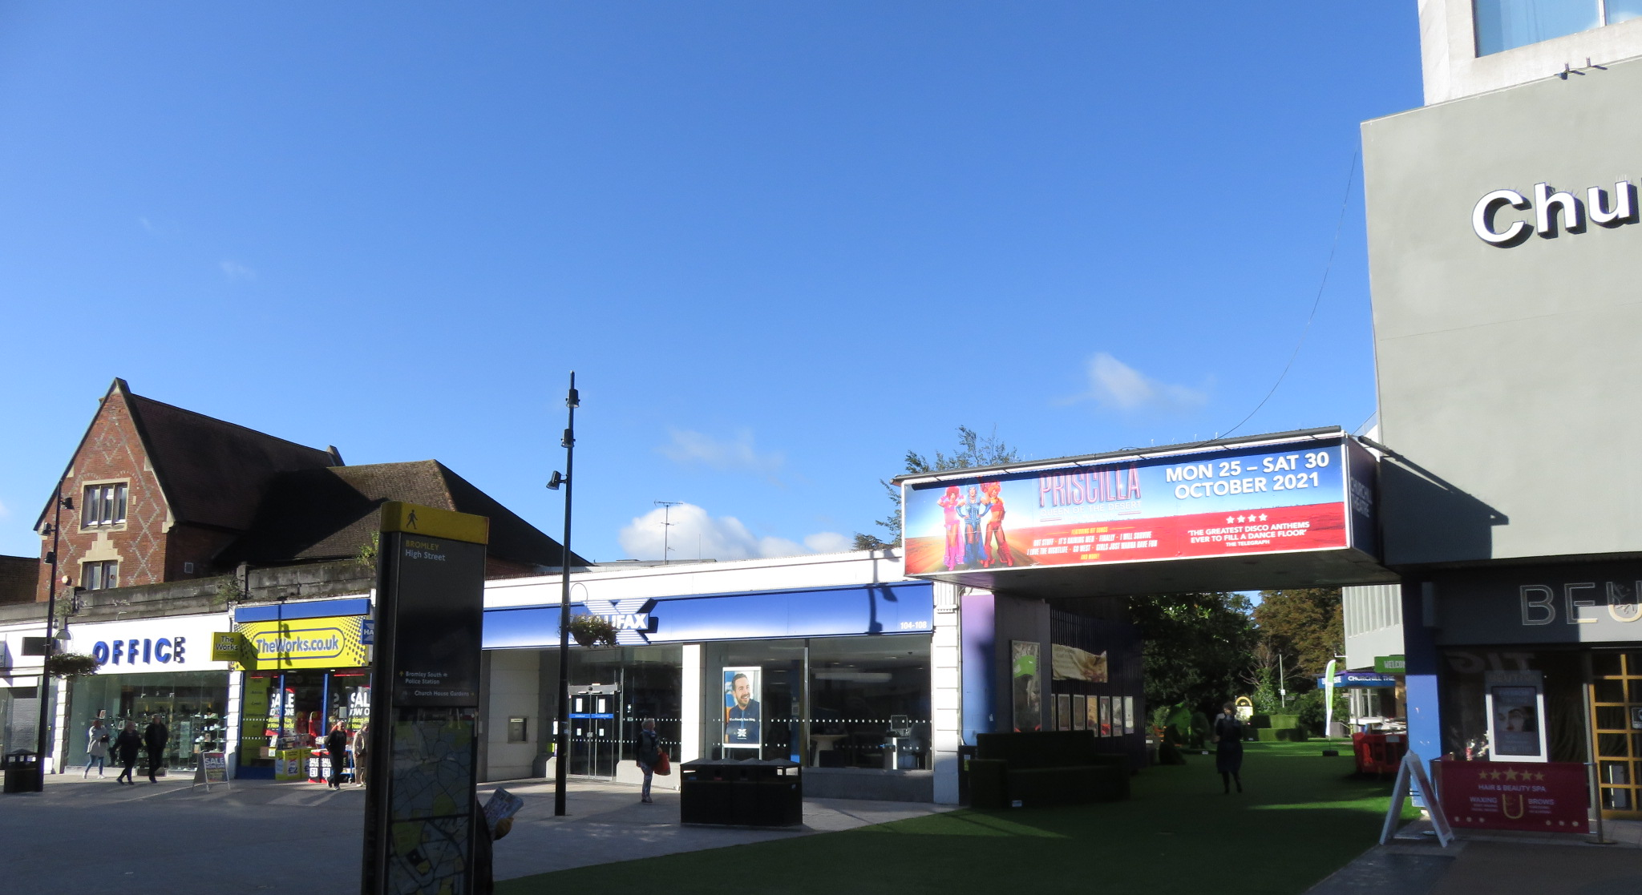
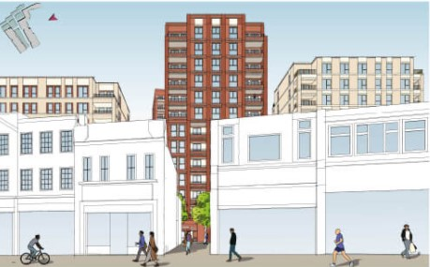
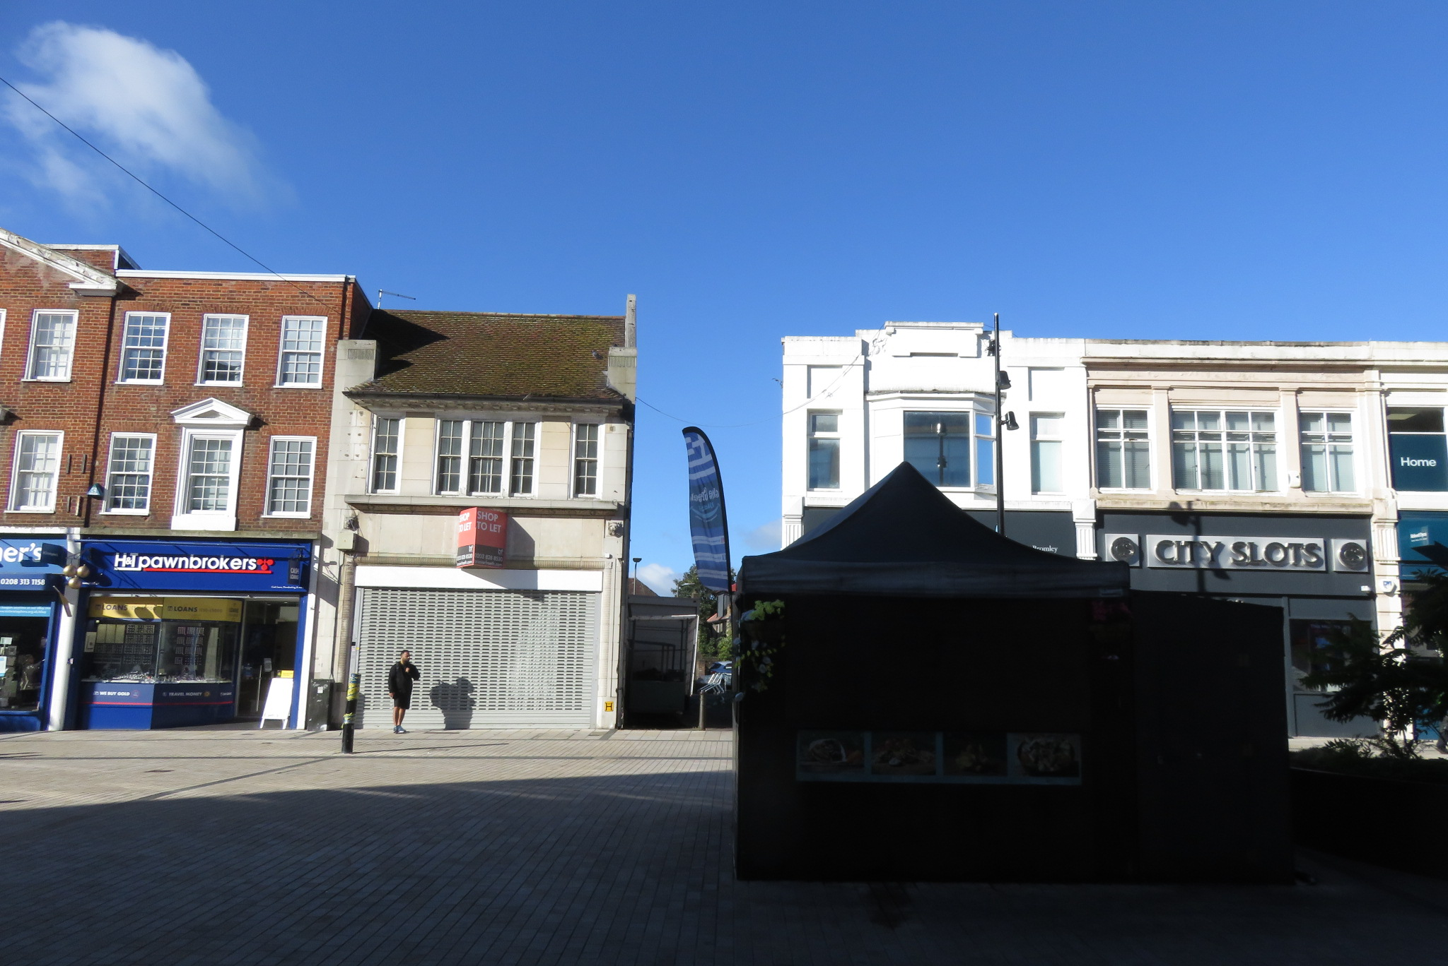
Churchill Quarter

Slide 18
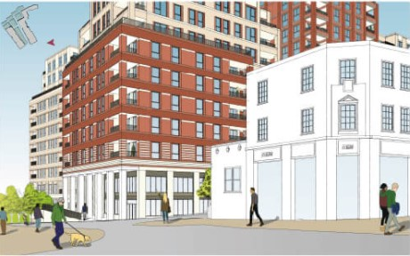
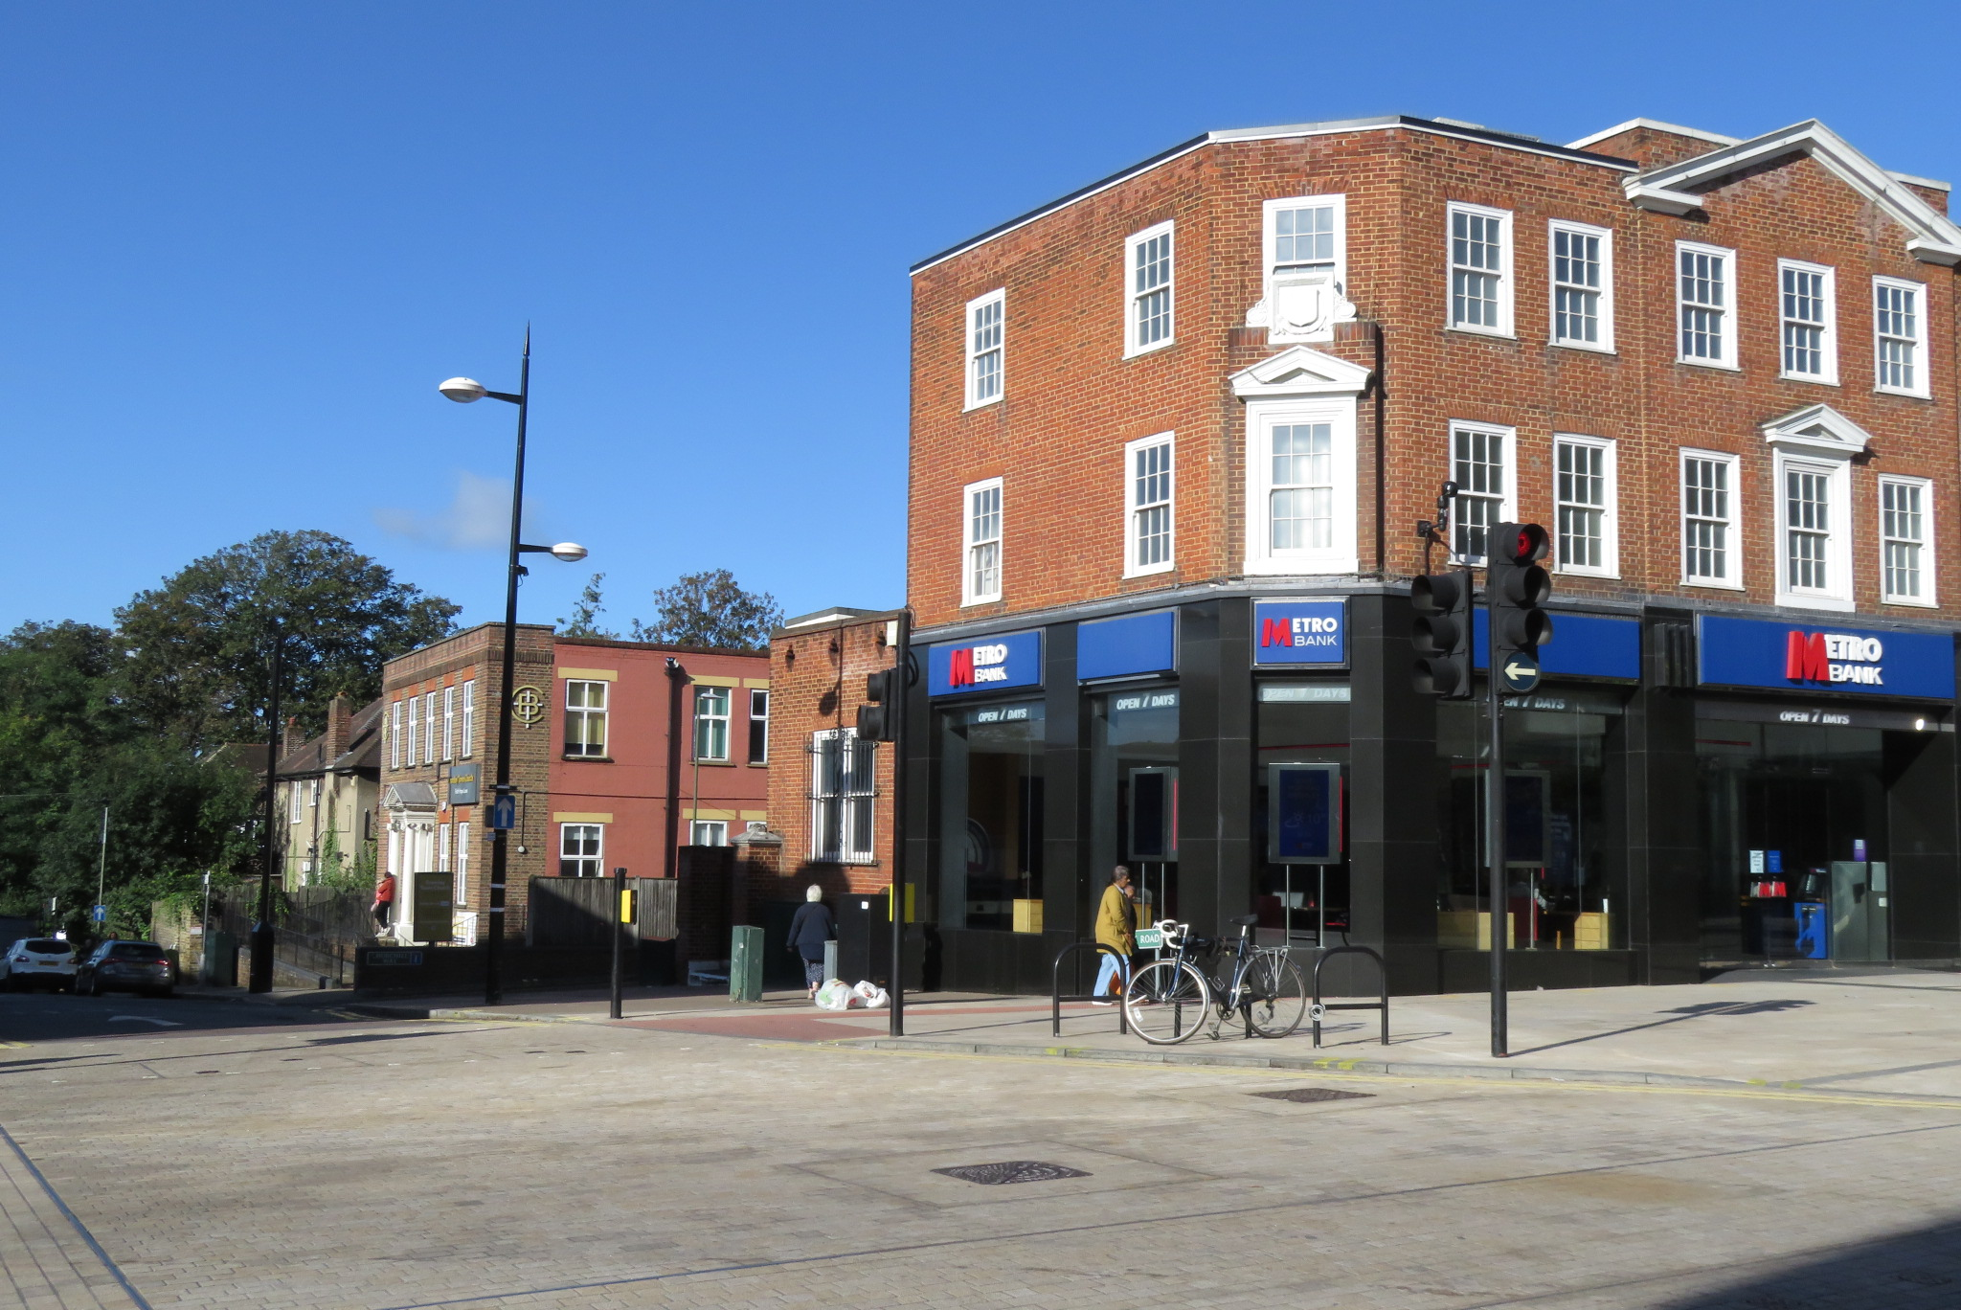
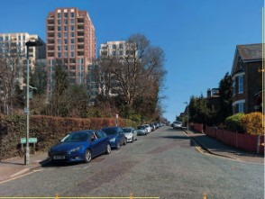
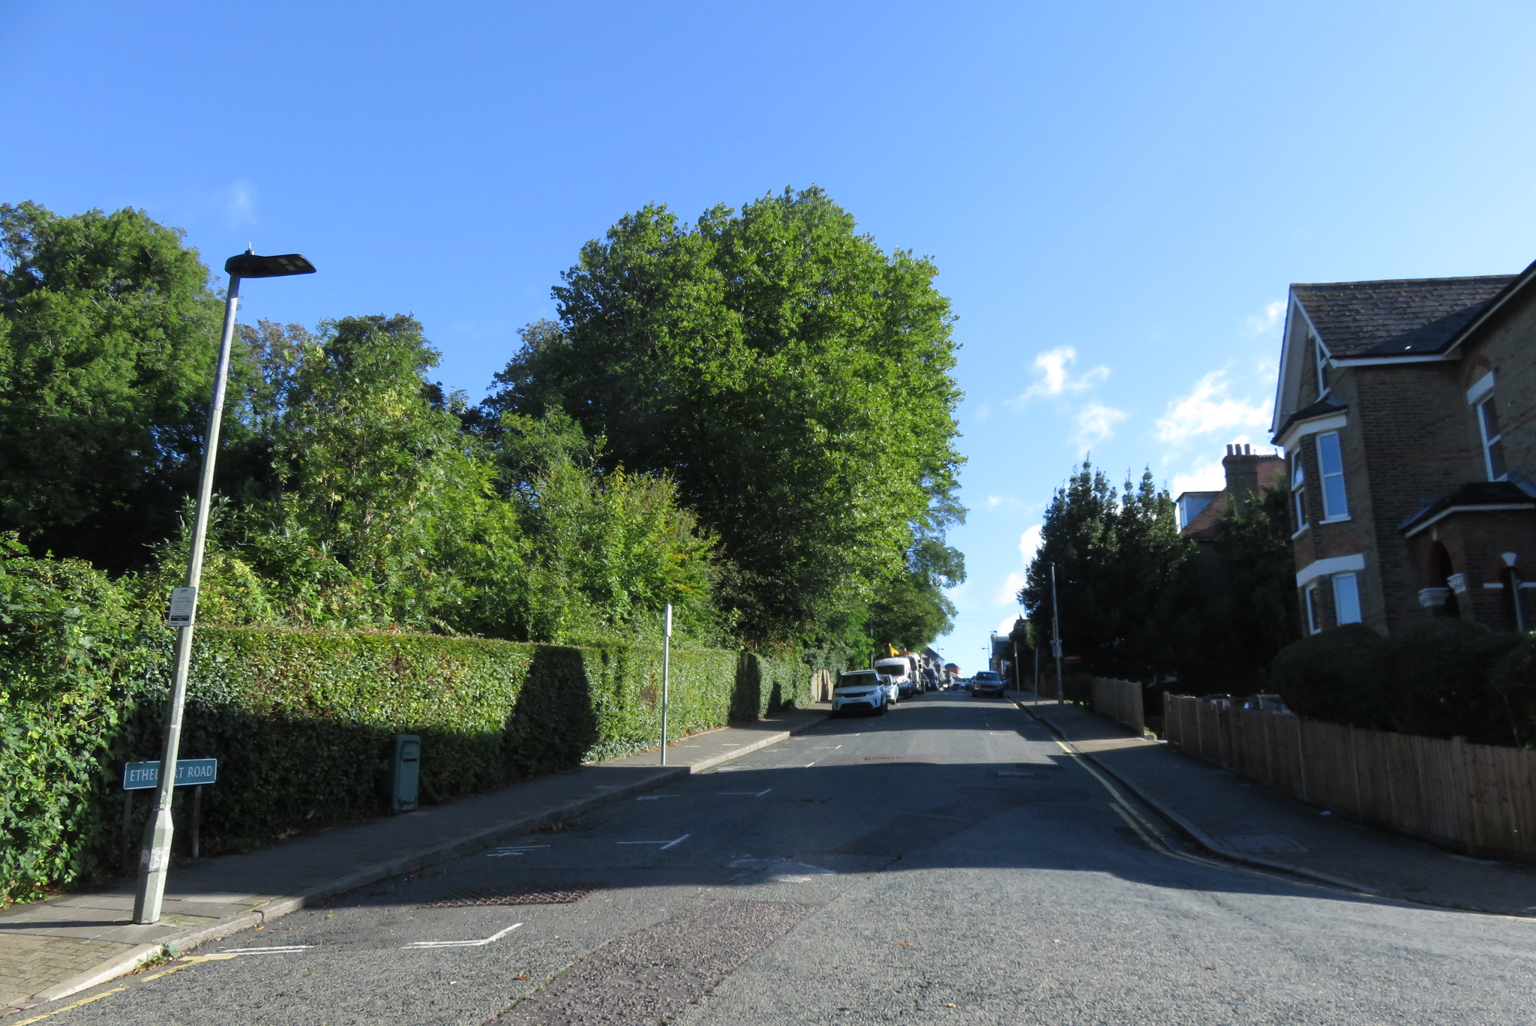
Churchill Quarter

Slide 19
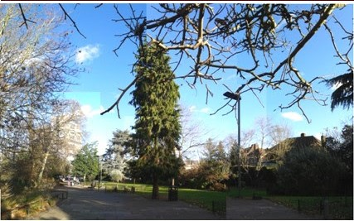
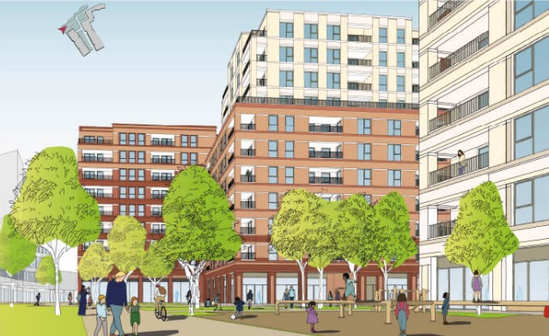
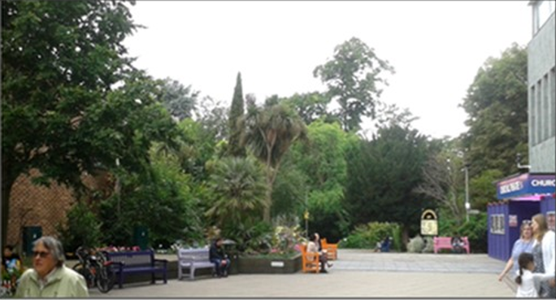
Churchill Quarter

Slide 20
Churchill Quarter
Views from Queen’s Mead

Slide 21
Churchill Quarter
Please write to your ward councilor.
Find their address on:
Bromley.gov.uk/Council and Democracy
and/or write to Bromley Council’s leader:
by email: Colin.Smith@bromley.gov.uk
by post:
Colin Smith
c/o Members Room Bromley Civic Centre Stockwell Close Bromley BR1 3UH
Make this an election issue…

Slide 22
62 High Street former Laura Ashley, building
Permitted March 2022

Slide 23
Bromley town centre Supplementary Planning Document (SPD)
Orpington town centre (SPD) open for consultation until 1st June
Guidance note 2:
… proposals should make a positive contribution …reinforce local identity and sense of place
Guidance note 11:
… proposals for tall buildings must provide detailed justification….ensuring that their massing, scale and layout enhances the character of the surrounding area.
…but for the Walnuts:
…higher density development, predominantly 3 to 9 storeys
…a single taller element of around 12-15 storeys

Slide 24
Look at the Orpington SPD:
Send your comments:
by email to: ldf@bromley.gov.uk
In writing to: Head of planning policy and strategy, Civic Centre, Stockwell Close, Bromley BR1 3UH;
Or online at bromley.gov.uk/consultation, select Orpington Town Centre SPD and use the Survey Monkey
Comment on the Walnuts Planning Application: 21/05907/OUT
…and look out for the Bromley town centre SPD

Slide 25
How to comment on planning applications…
Go to bromley.gov.uk
Select ‘Planning’
Select ‘Search planning applications’
Put in the reference number or single line of an address
Click on the ‘Comments’ tab
Make your comment
Or email: planning@bromley.gov.uk
Or write to: Planning, Civic Centre, Stockwell Close, BR1 3UH quoting the planning reference number and your name and address
21/05420/FULL1
Conquest House, 25 Elmfield Road
21/00741/FULL1
33-41 MASONS HILL
21/05585/FULL1
2-4 Ringers Road
21/05907/OUT Walnuts Shopping/Leisure Centre, Orpington

Slide 26
Heritage walks and exhibition this summer
Workshops: Saturday 30th April and Saturday 21st May
Interested? Email chair@bromleycivicsociety.org.uk

Slide 27
Questions….?

