Slide 1
London borough of Bromley
BROMLEY NORTH STATION – Planning Policy REVIEW
Presentation BRRA – 26th July 2016

Slide 2
The Site
A complex but underutilised site – multiple stakeholders – NR/Tfl/LBB/SE Trains/NHS
Opportunity to deliver new residential quarter for Bromley together with:
Office space
Community facilities
Better bus interchange (Rail Services ?)
Improved public space around the Listed Station

Slide 3
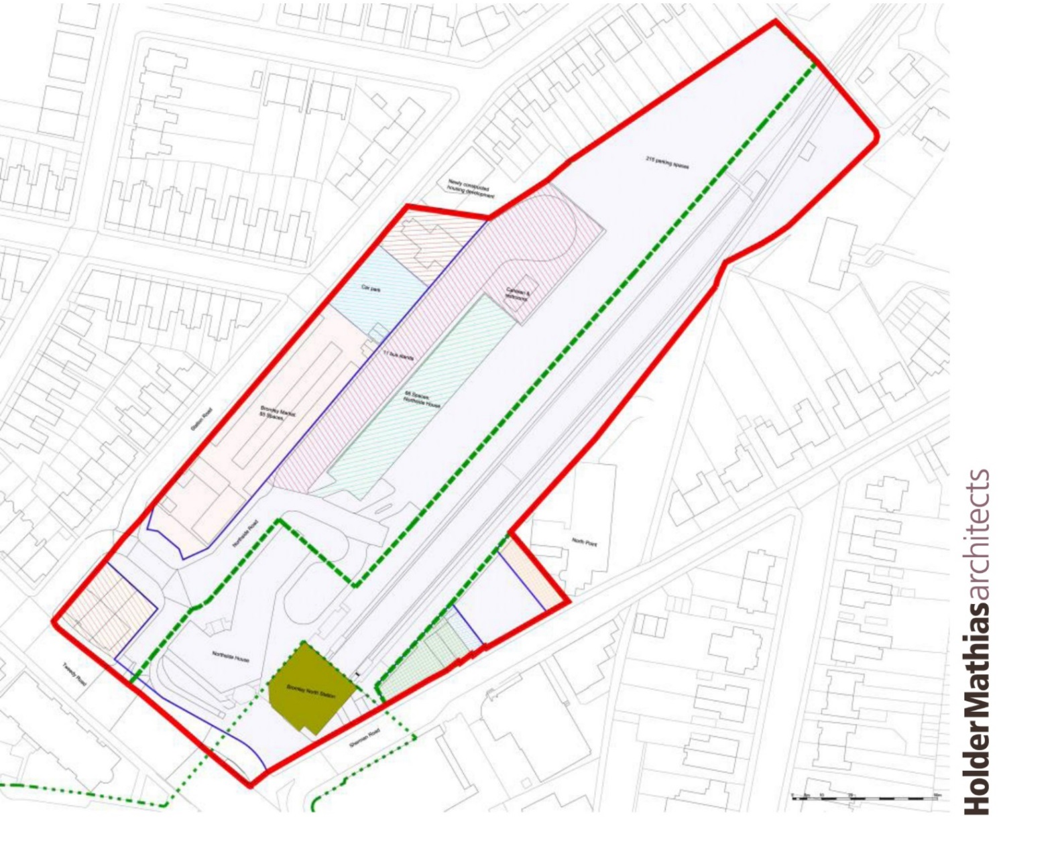
Ownership Plan

Slide 4
2010 Area Action Plan
2010 AAP Policy had a ‘around 250 Residential Units’.
Policy successfully challenged by Linden Homes resulting in policy being quashed on viability issues.
2012 Council required to prepare, publish, consult and promote a new policy.
2015 Local Plan Draft allocations -Allocate for mixed uses including residential, office, retail and transport interchange (approx. 250 units).

Slide 5
Site A Spatial Strategy
AAP Design Guidance for Opportunity Site A still relevant.
Possible locations for taller buildings
Development areas
Pedestrian connections

Slide 6
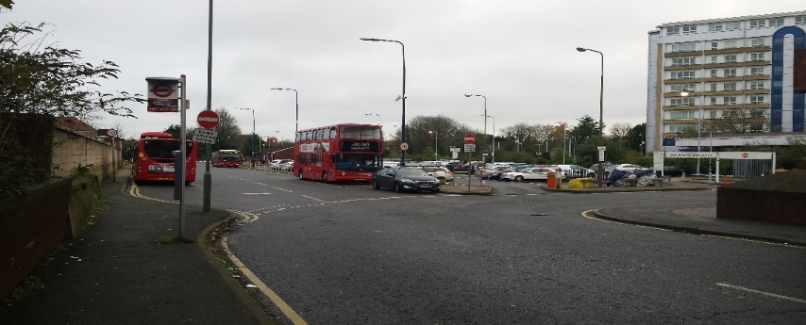
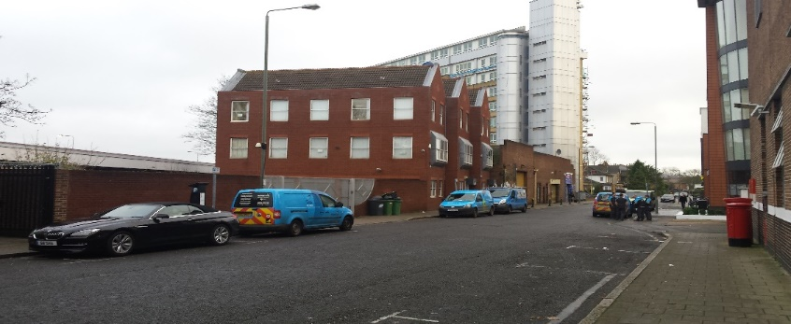
Urban Design Brief
Review the urban design implications for a range of densities to inform an understanding how the development would sit within the locality and safeguard residential amenity
Assess the viability for a comprehensive development on the basis of a range of development densities
Output to be used to inform Local Plan Site allocation
Meetings held with Network Rail and Prime Place to understand their proposals

Slide 7
Prime Place/Network Rail
Prime Place (PP) close to signing Development Agreement with NR
PP ownership of Tweedy Rd properties and an option over Sherman Rd land
Actively considering first phase options on Sherman Rd
Major of London/DfT pressing PP for density – but looking for density and financial return
NR/South East Trains potentially willing to reduce car parking by over half to 100 spaces
Tfl requirements yet to be finalised but c 16 bus stands

Slide 8
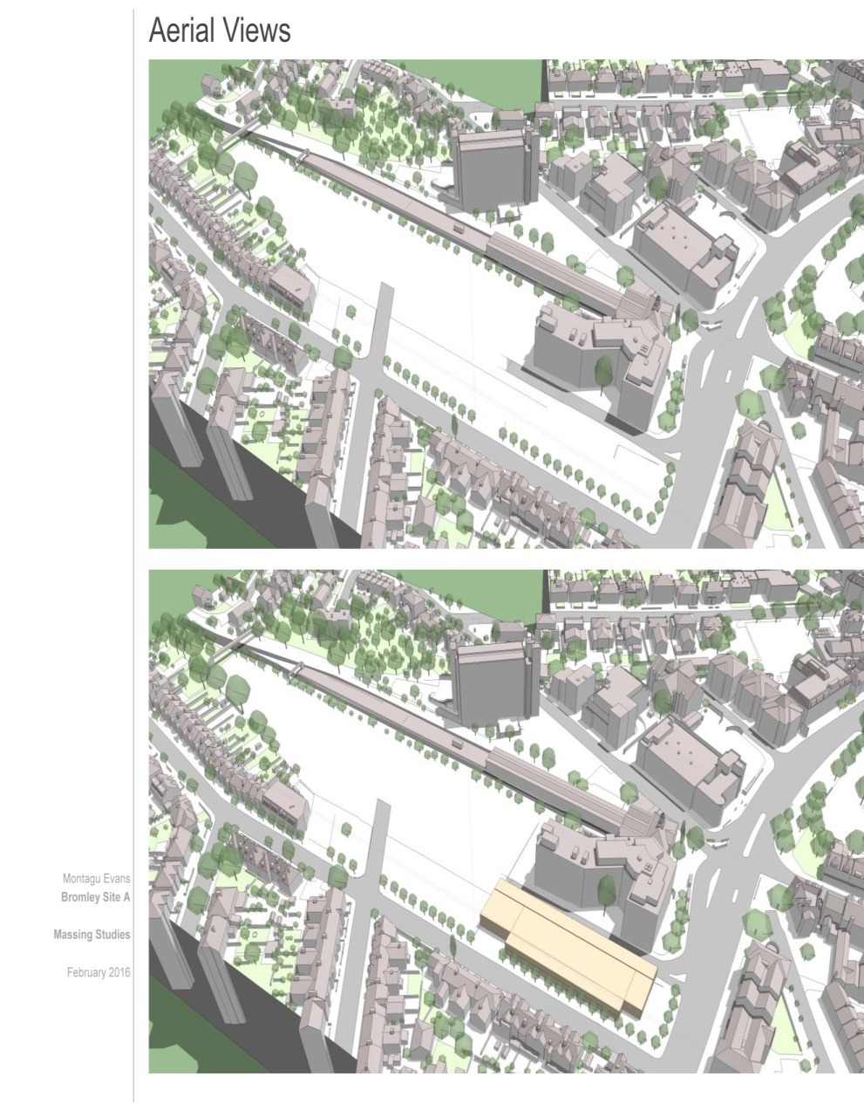
Assessing Massing Impact

Slide 9
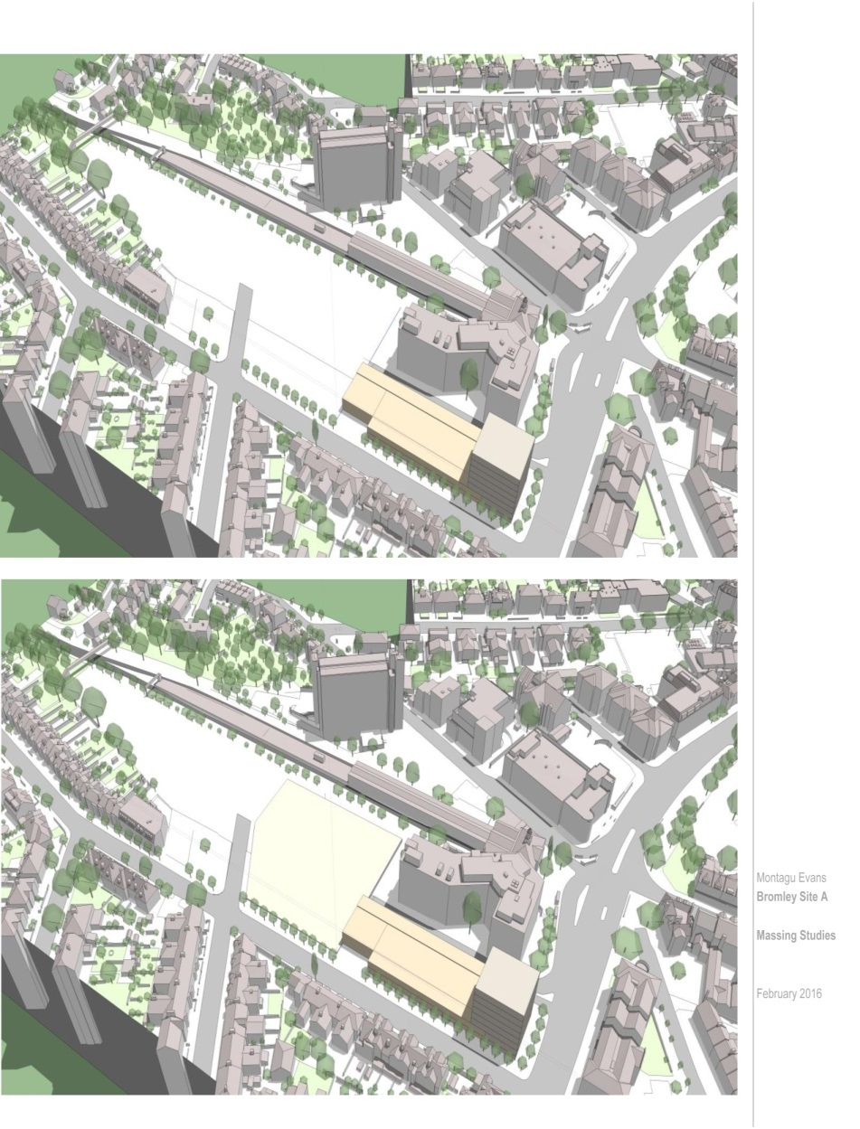
Assessing Massing Impact

Slide 10
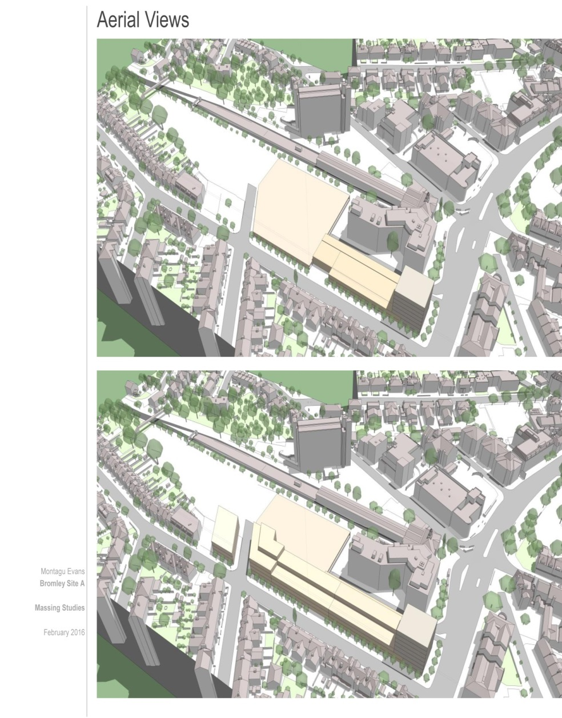
Assessing Massing Impact

Slide 11
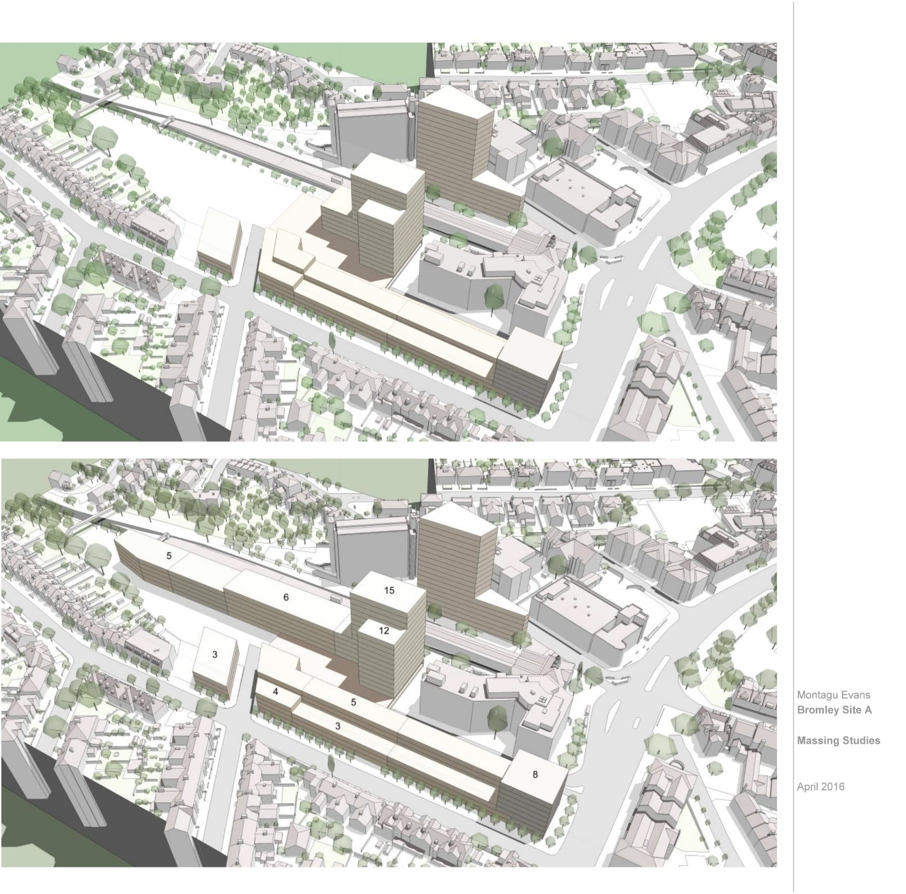
Assessing Massing Impact

Slide 12
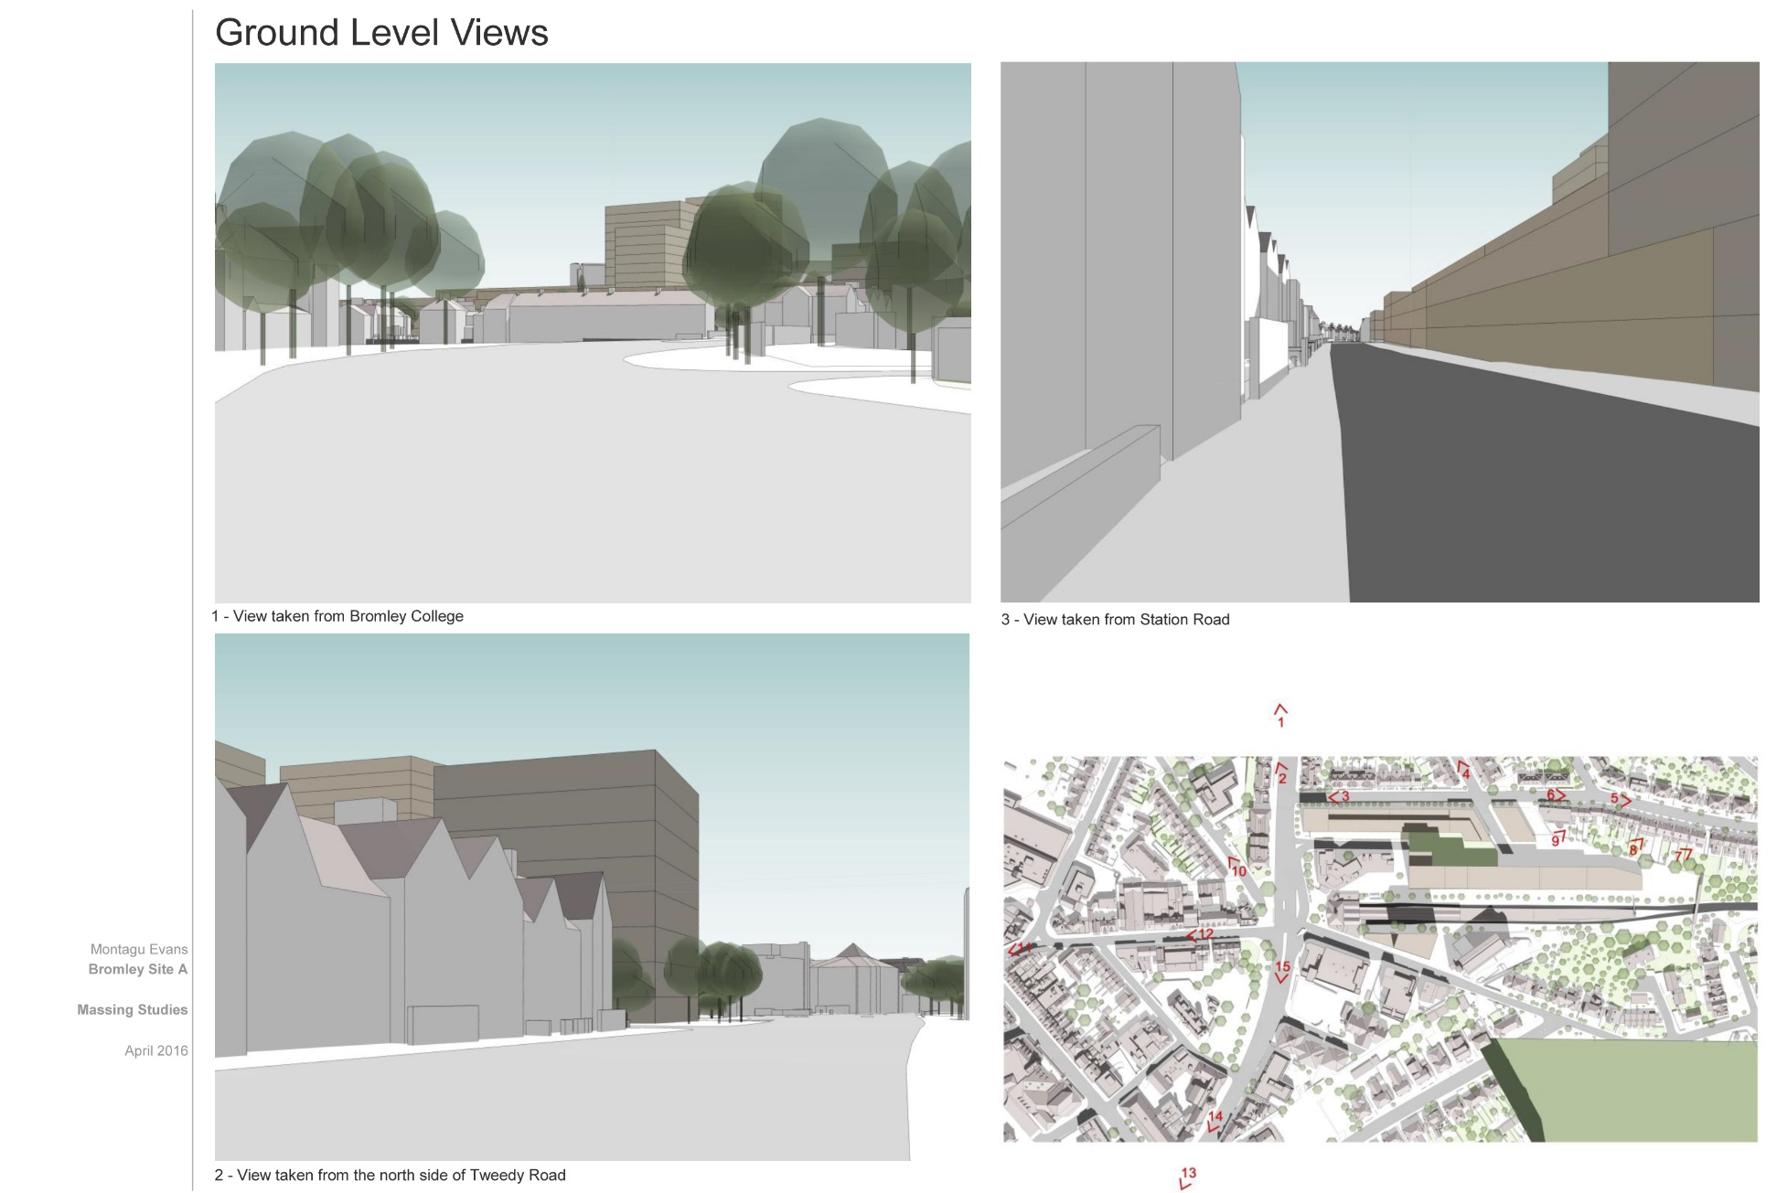
Assessing Massing Impact

Slide 13
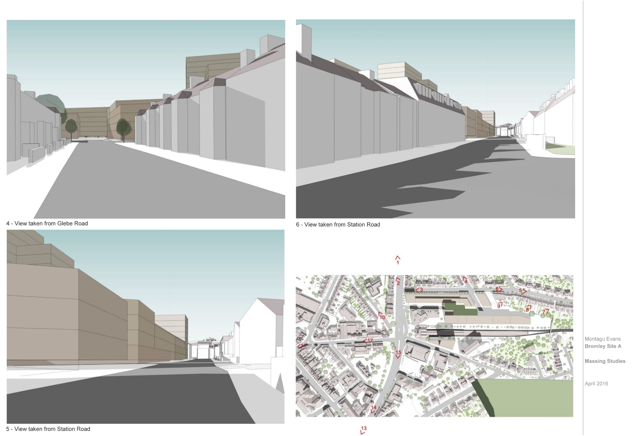
Assessing Massing Impact

Slide 14
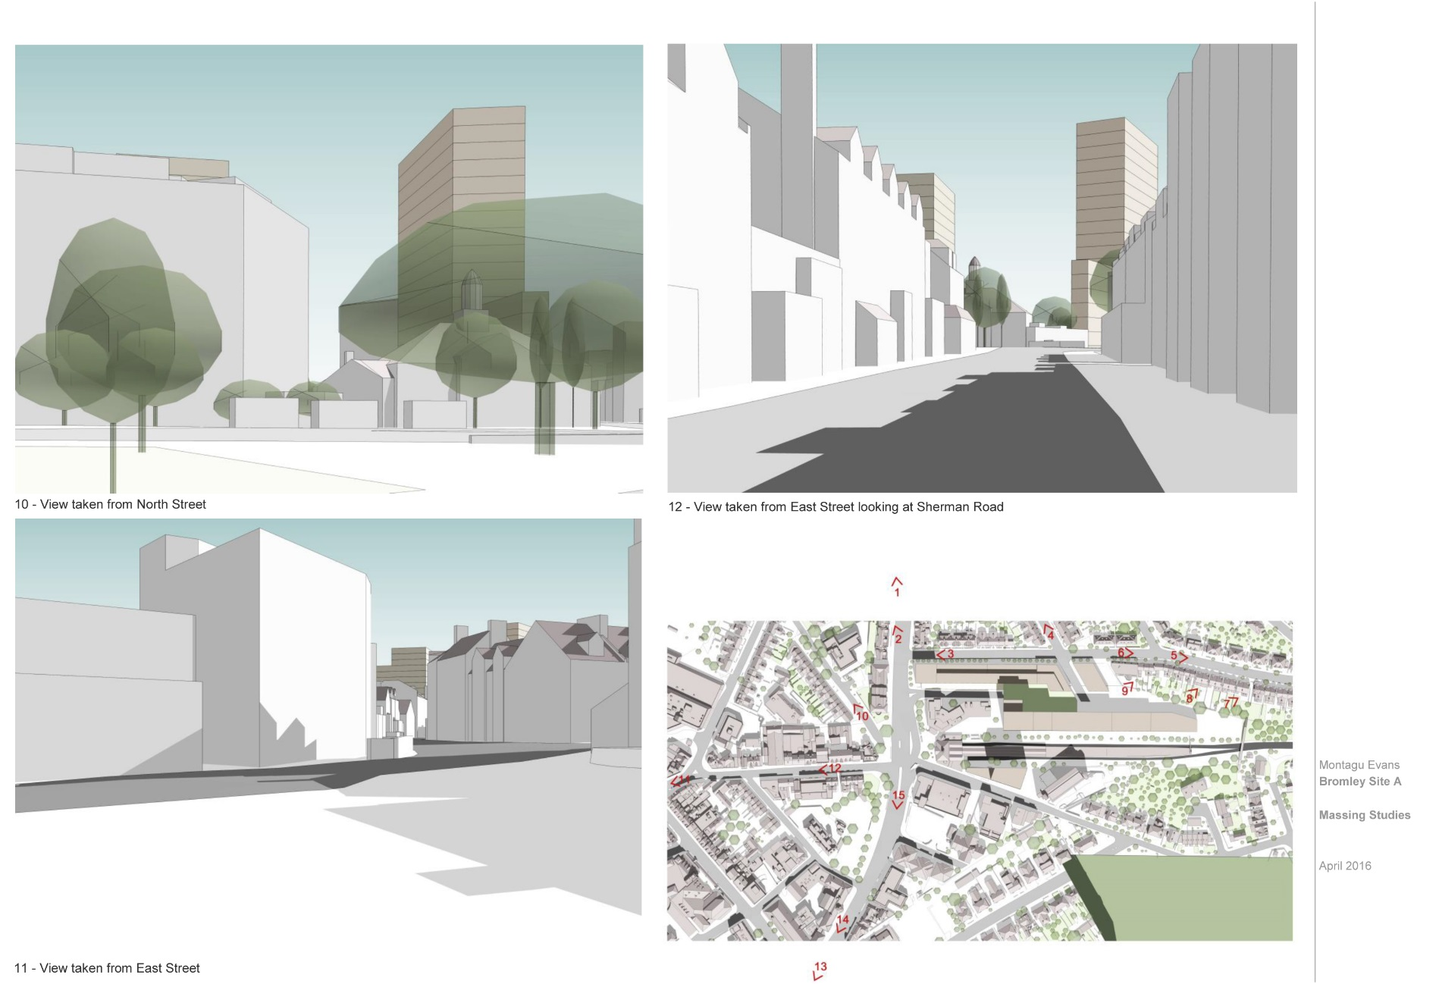
Assessing Massing Impact

Slide 15
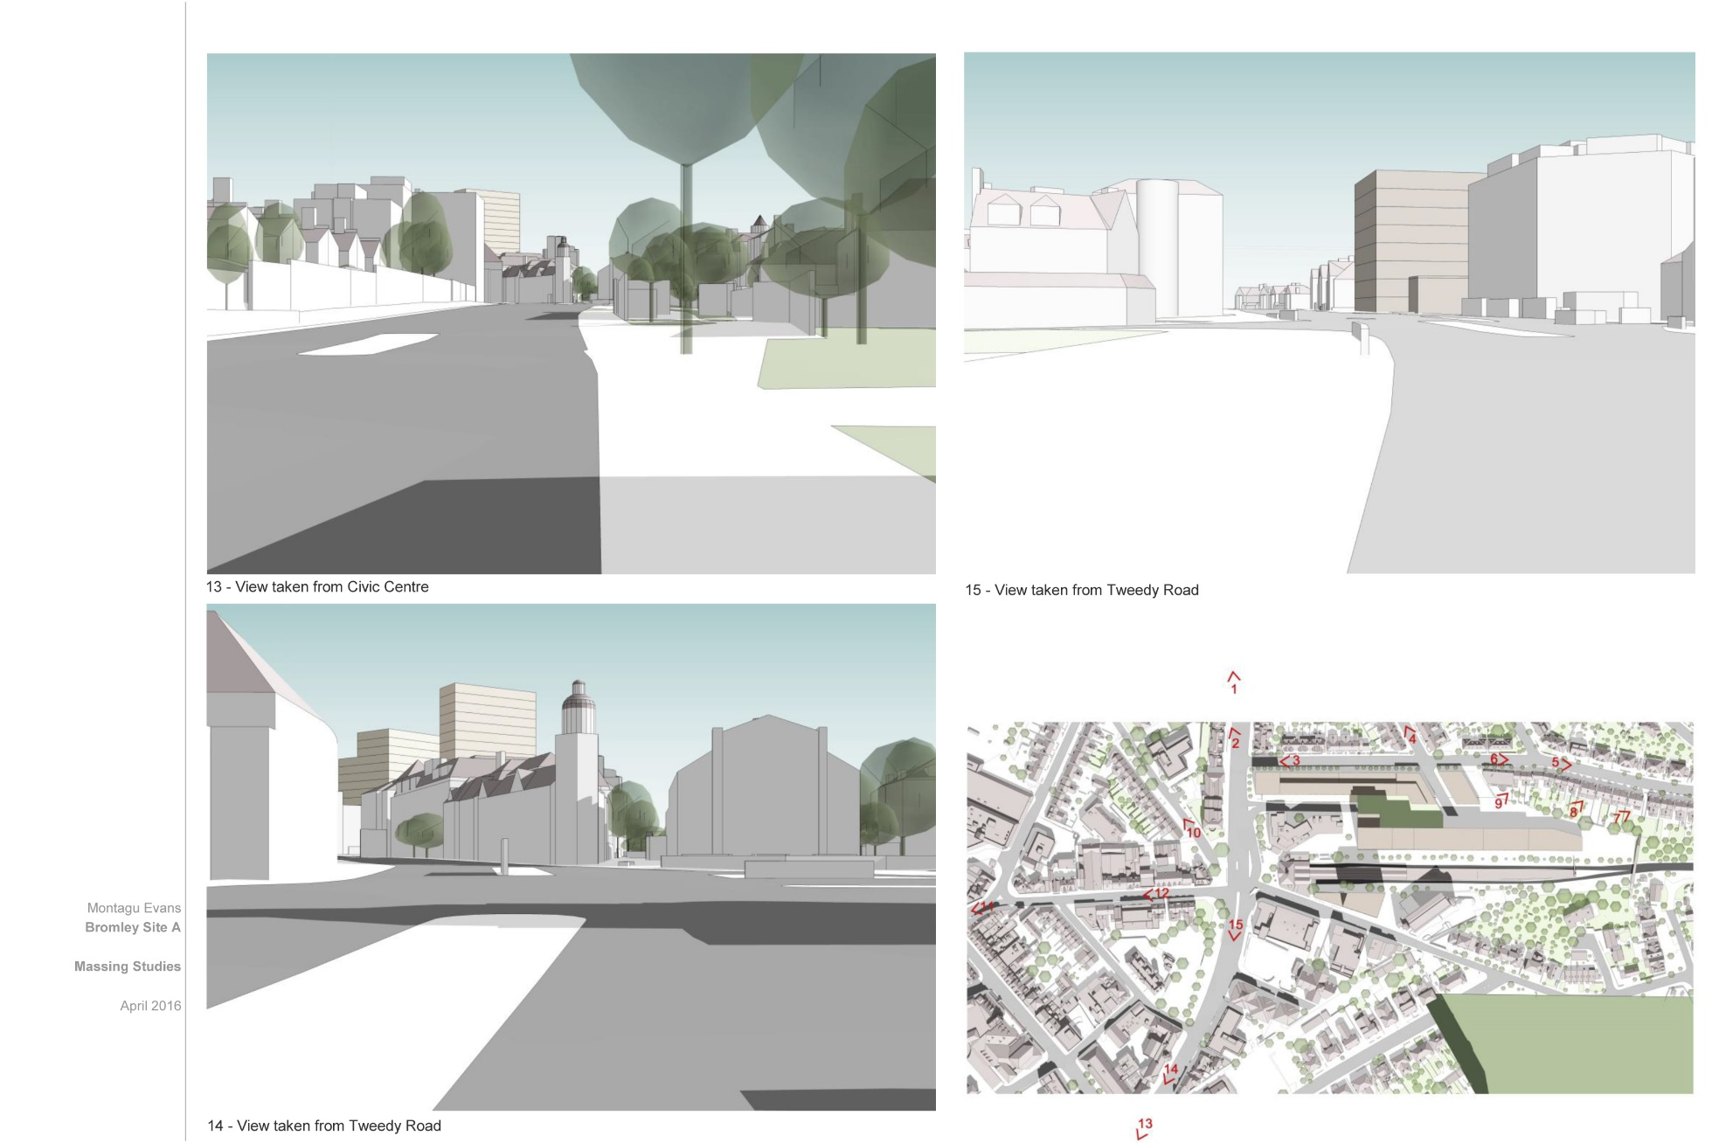
Assessing Massing Impact

Slide 16
Local Plan Timetable
Draft Plan Approved by Executive Oct 2016 for consultation
Consultation on Draft Plan Sept-Oct 2016 (6 Weeks)
Submission of Plan for Examination Jan 2017
Examination in Public Mid 2017

